Slide 1

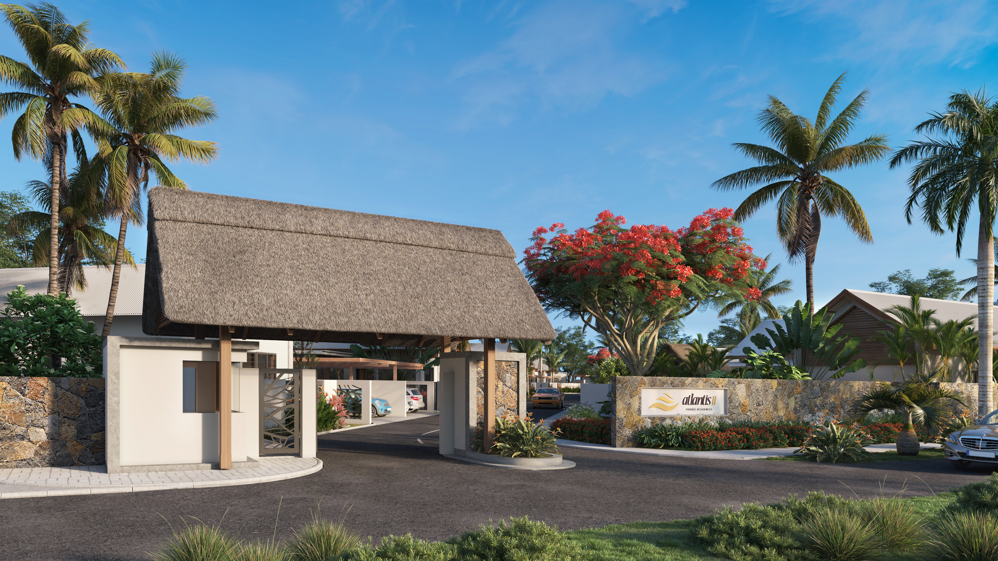

Slide 2
SUMMARY
Discover the Atlantis II Private Residences Grand Bay, a prestigious development comprising 18 luxurious villas with three or four bedrooms, each equipped with a private swimming pool.
This high-end project also offers a Spa and Fitness center to meet all your relaxation and wellness needs. Located in one of the most sought-after neighborhoods in Mauritius, this exclusive residential complex is aimed at an international clientele with a residence permit.
Enjoy a superior quality of life in a peaceful and secure environment, close to all the amenities and attractions of the region. For nature enthusiasts, Atlantis II Private Residences Grand Bay provide easy access to white sand beaches, turquoise lagoons and exciting water activities just a few minutes away.
For lovers of culture and history, the region is full of historical sites, museums and art galleries. Don't miss this unique opportunity to invest in a prestigious real estate project in Mauritius.
Contact us now to learn more about the Atlantis II Private Residences Grand Bay.

Slide 3
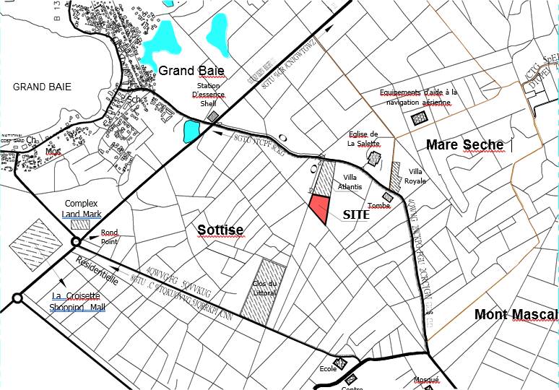
LOCATION PLAN
Atlantis II is located in a calm and tranquil backdrop of Grand- Baie but within minutes to the animated City Centre.
It boasts a collection of refined international hotels, a host of nautical activities and lively beach to bar nightlife, overlooking the world’s most stunning white beaches.

Slide 4
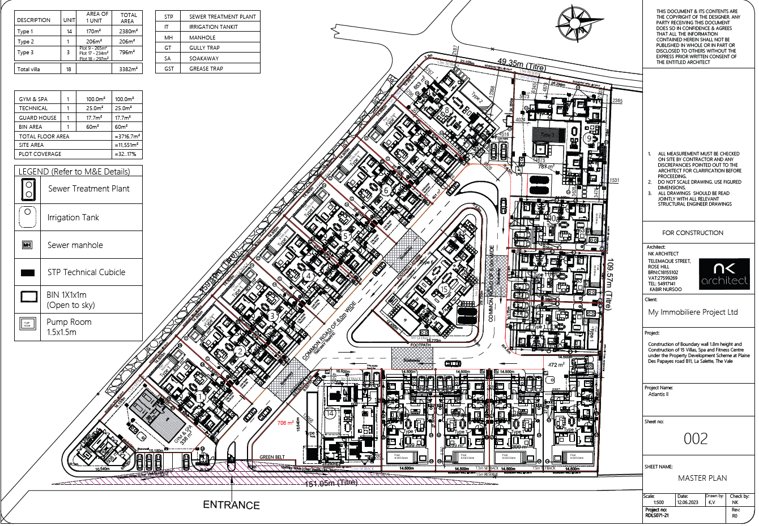
MASTERPLAN

Slide 5
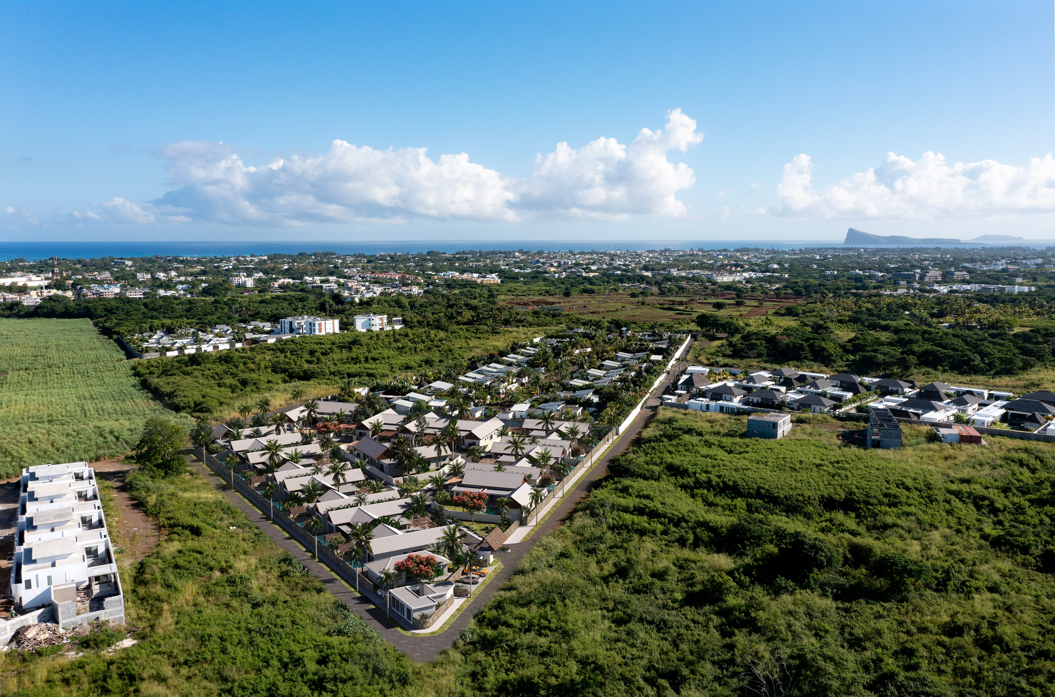
3D Illustration

Slide 6
THE CONCEPT
PRESTIGE VILLA FLOOR PLAN
The villa is designed in a contemporary architecture with an open concept living- dining area.
Arched under the blue sky and warm sun is your private pool where you may take a dip any time of the day.
And the interior features noble finishes with European kitchen, wood adorned deco and lush greenery.

Slide 7
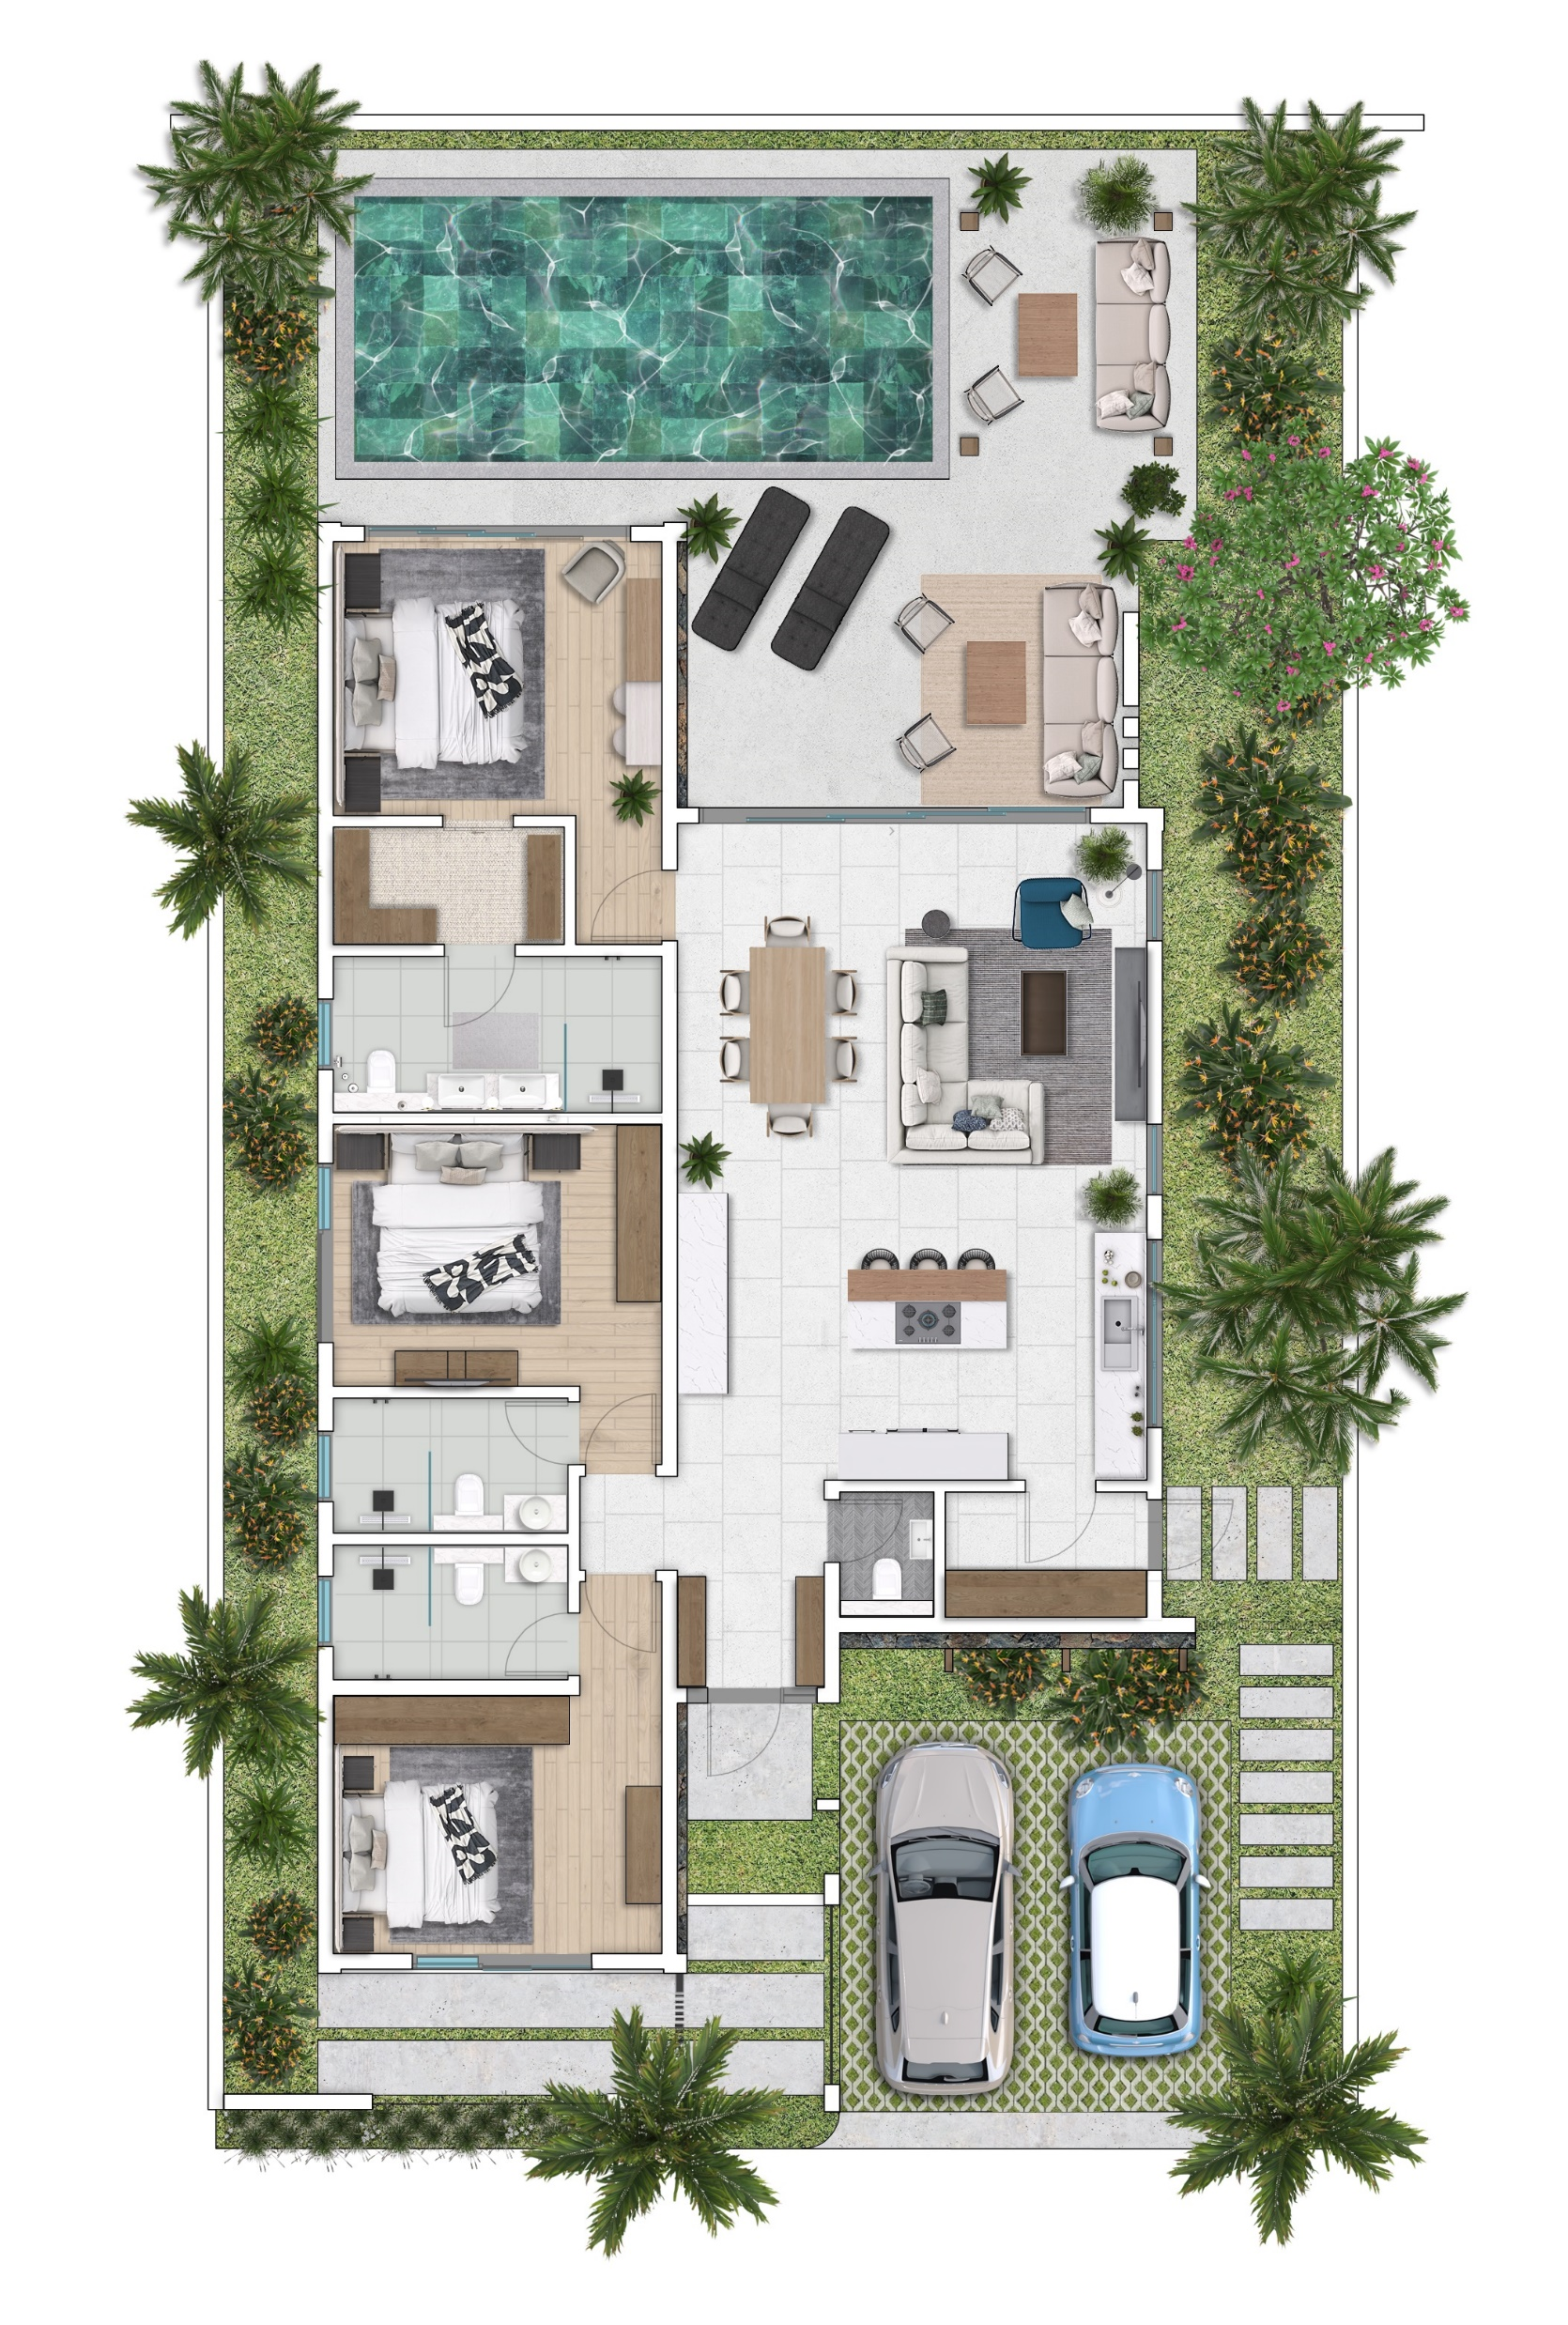
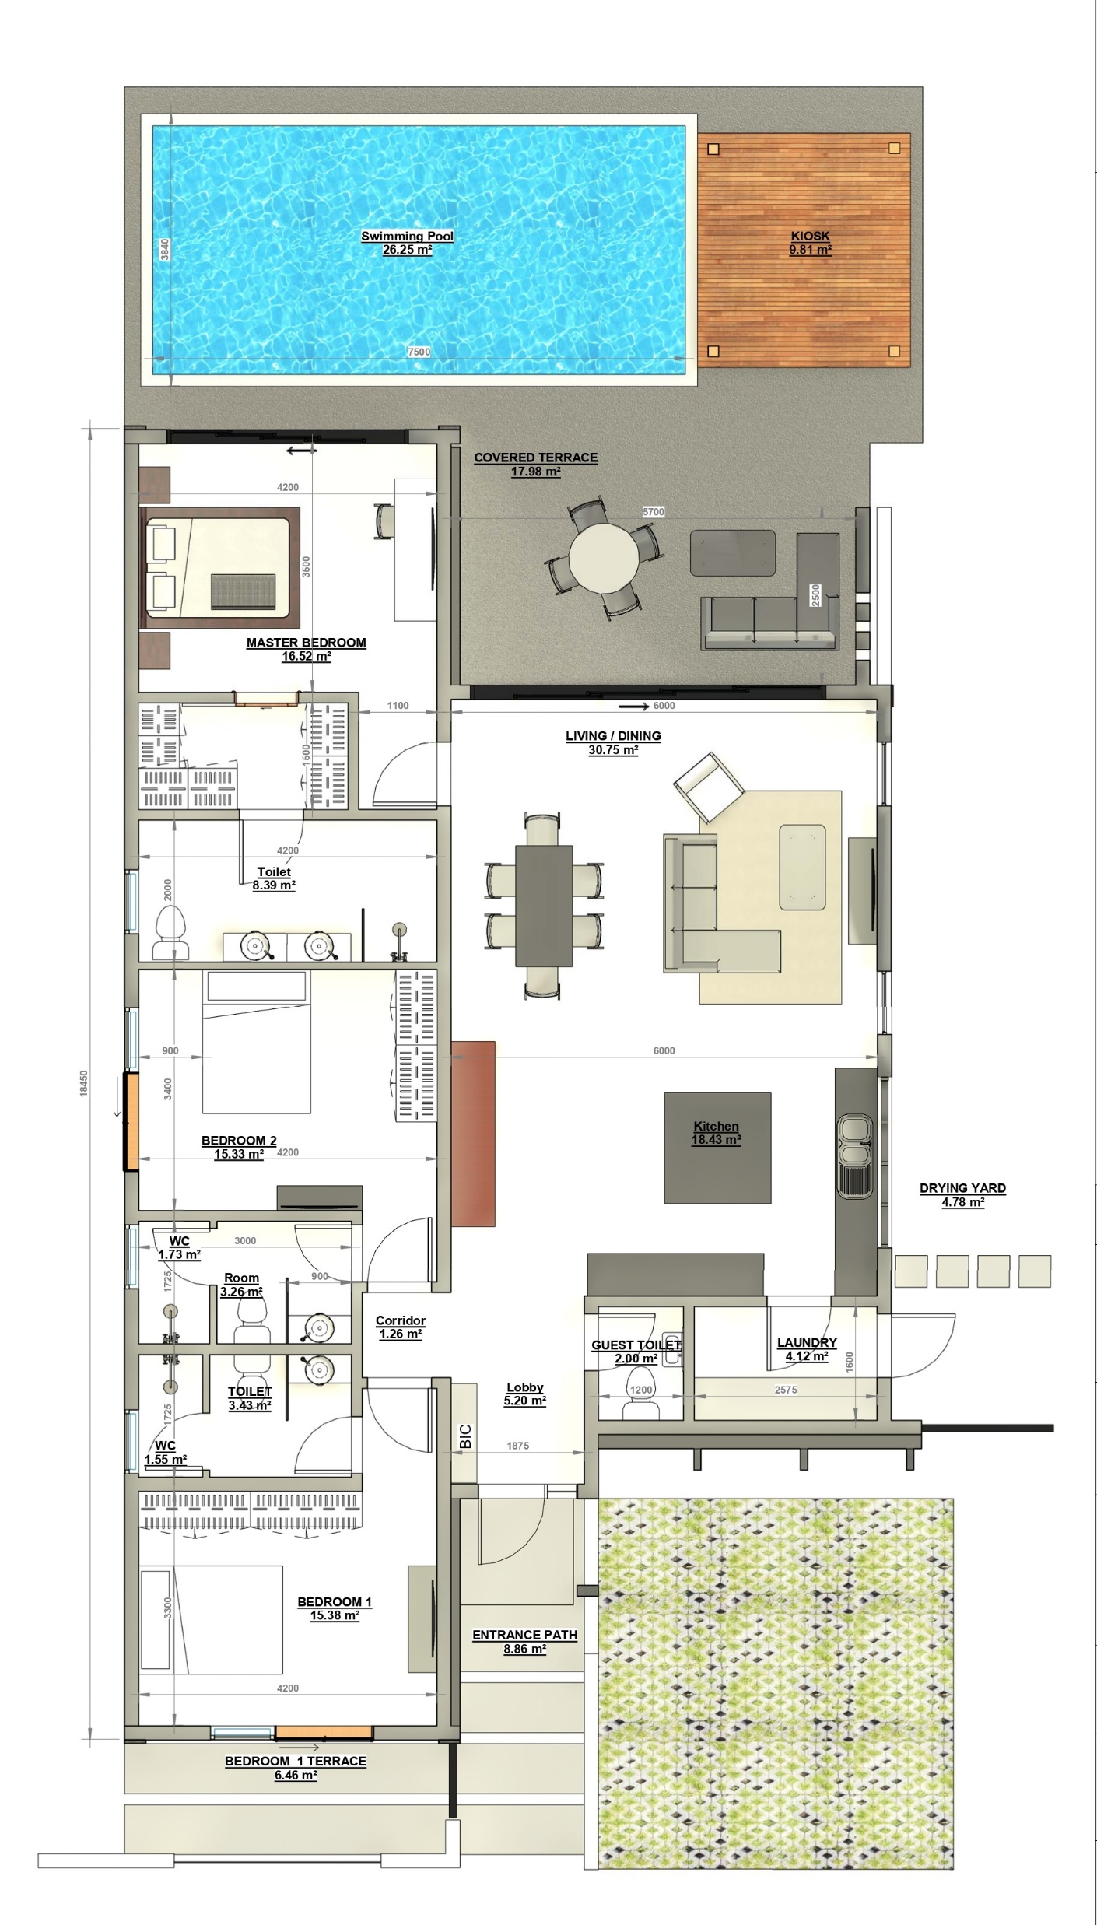
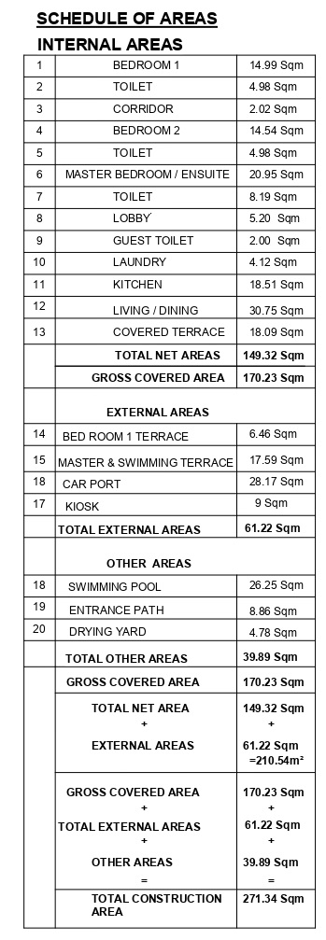

Slide 8
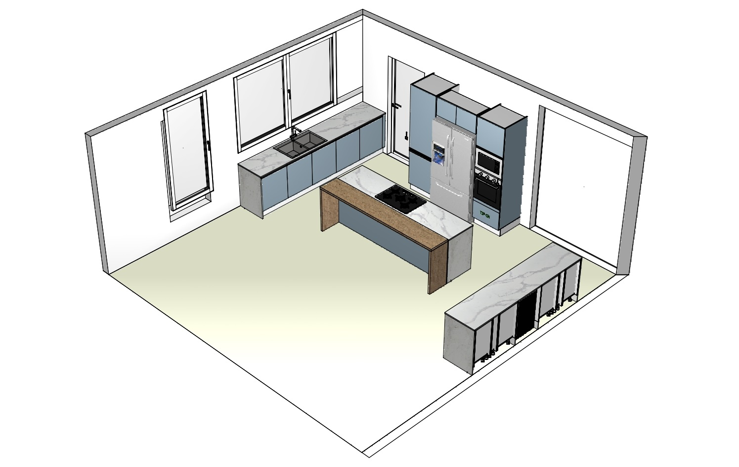
Kitchen Plan

Slide 9
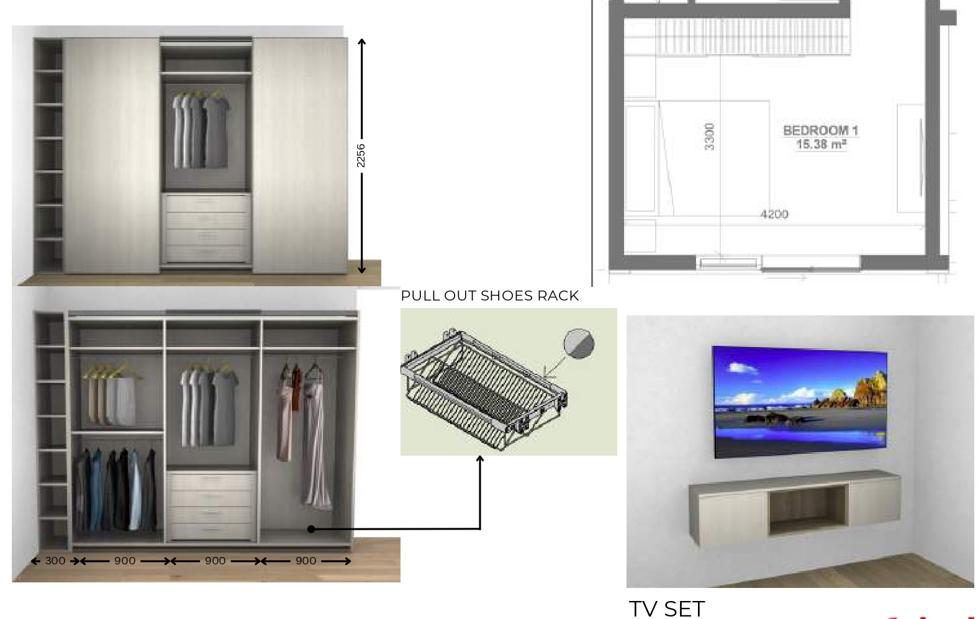
BEDROOM 01 – DRESSING

Slide 10
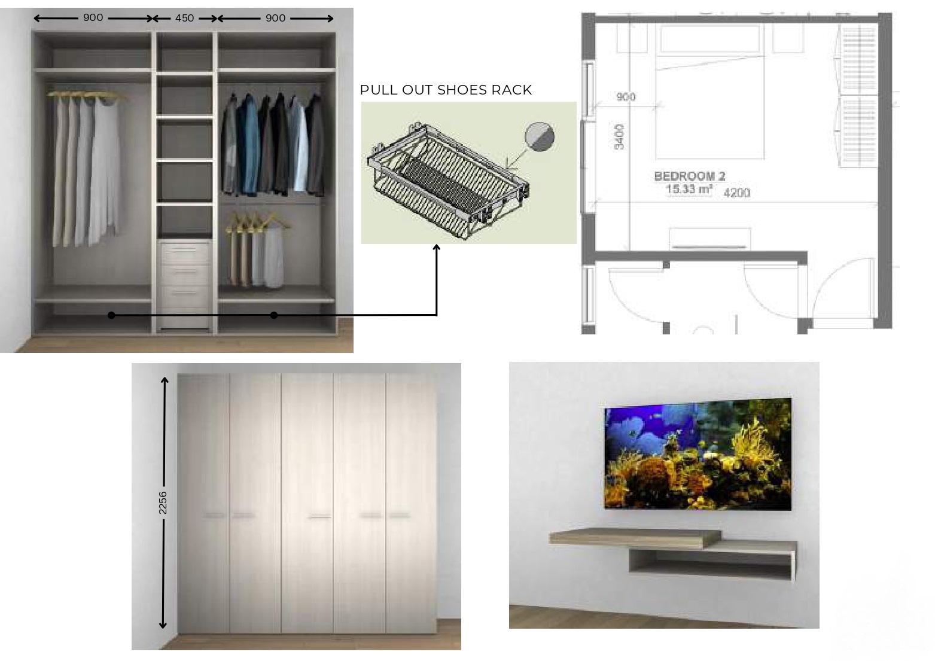
BEDROOM 02

Slide 11
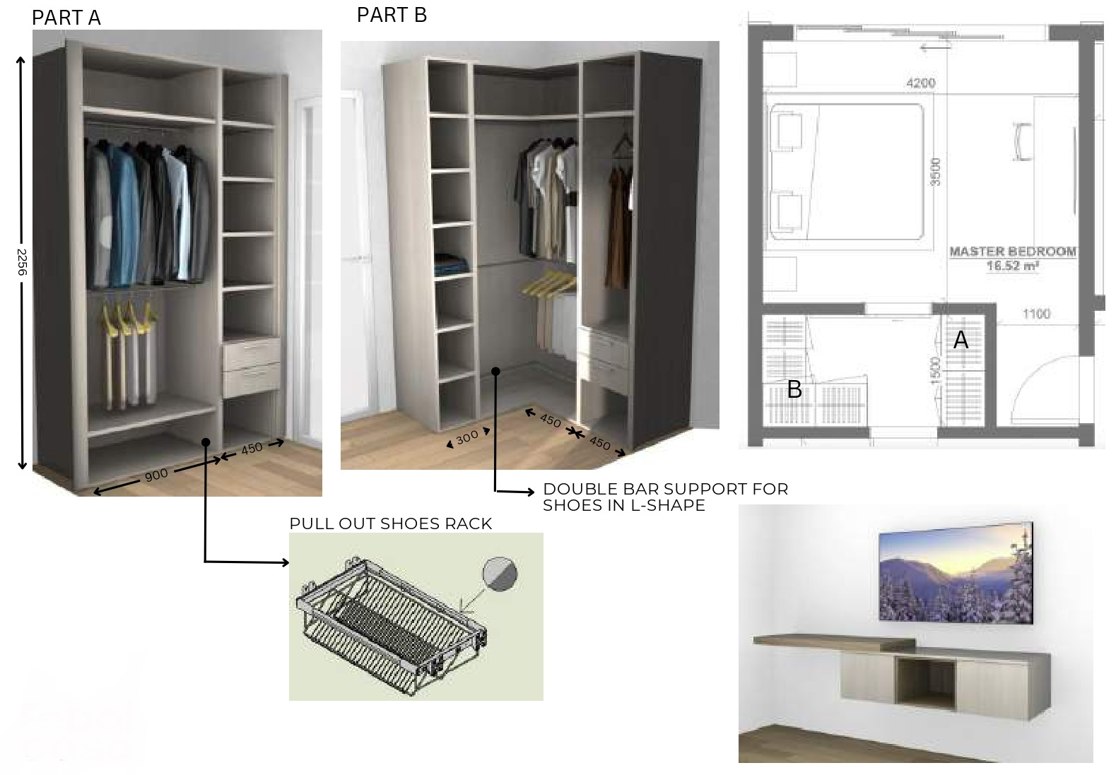
MASTER BEDROOM

Slide 12
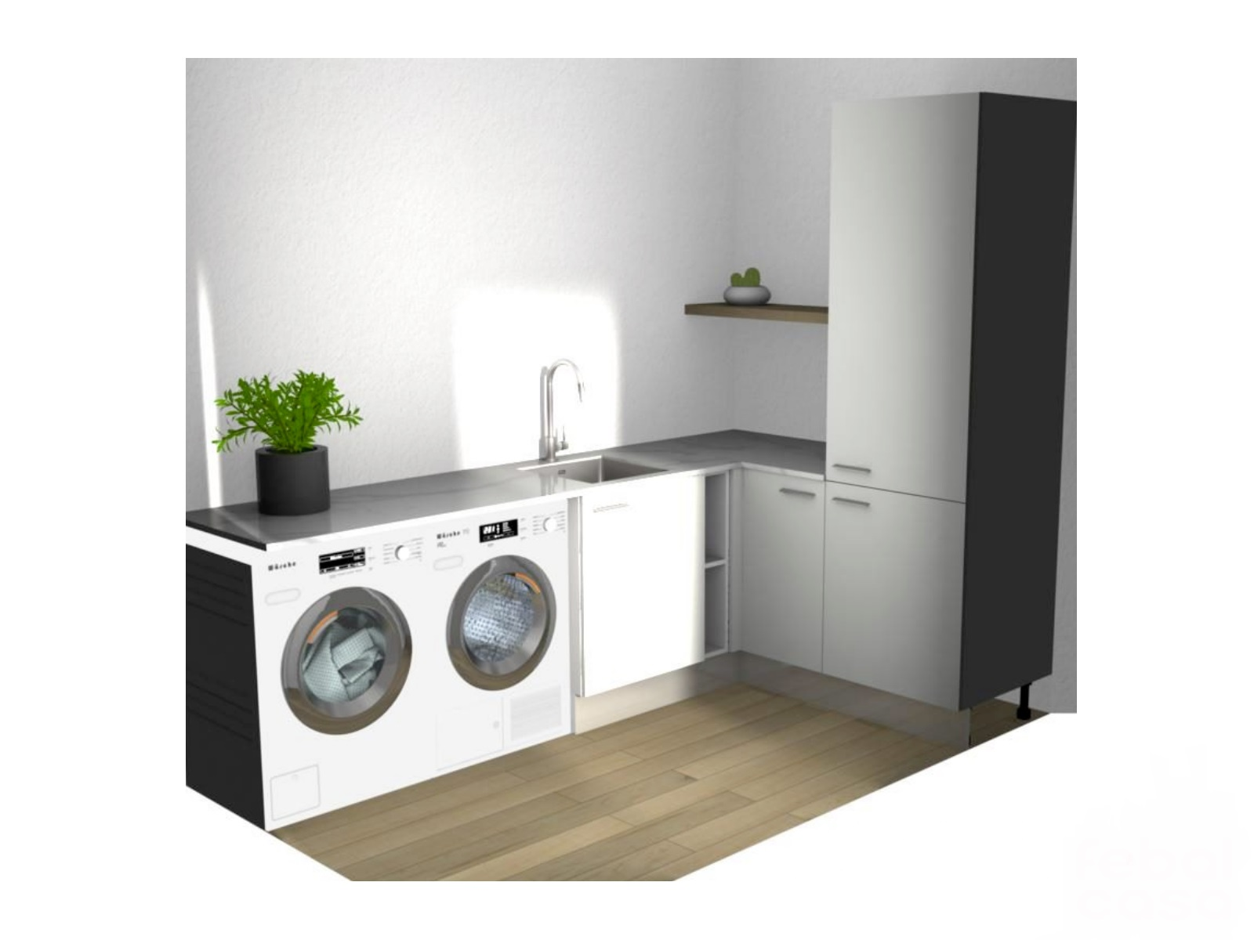
LAUNDRY

Slide 13
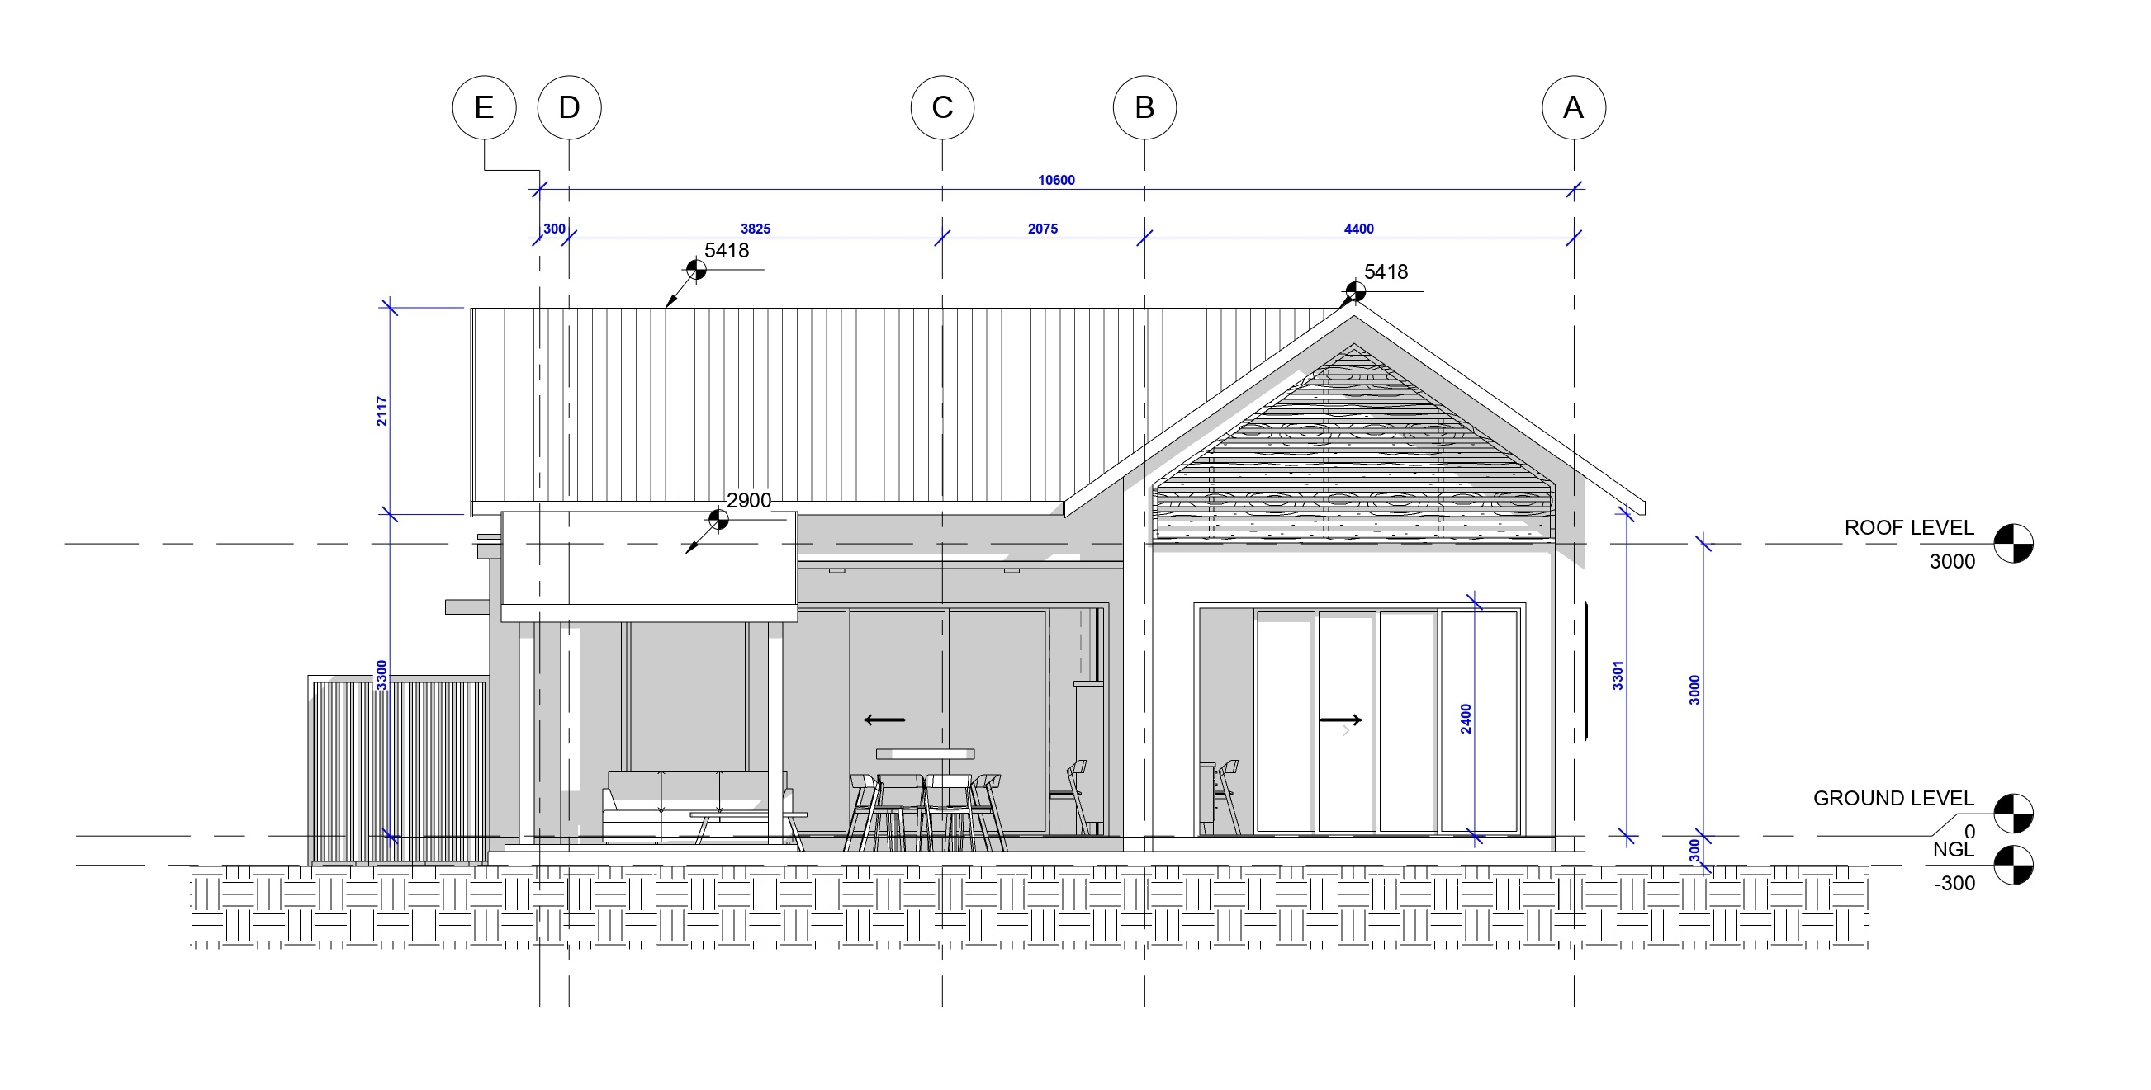
ELEVATION

Slide 14
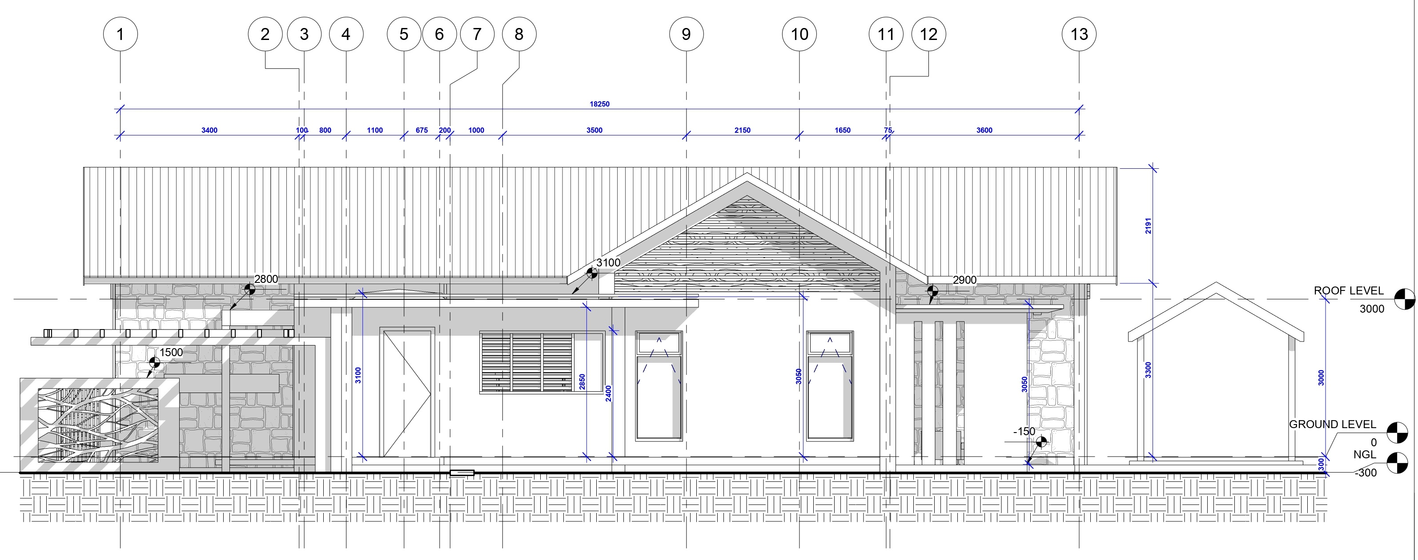
ELEVATION

Slide 15
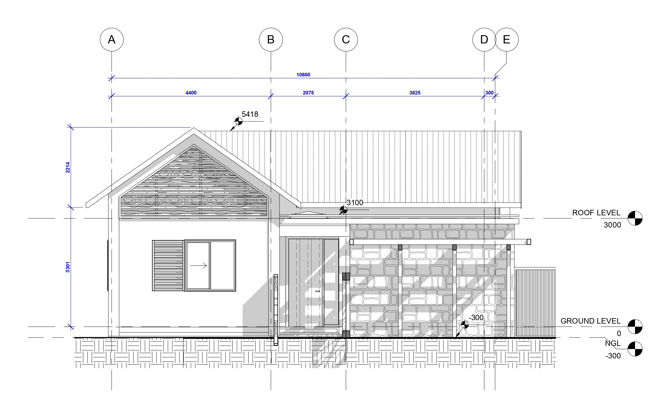
ELEVATION

Slide 16
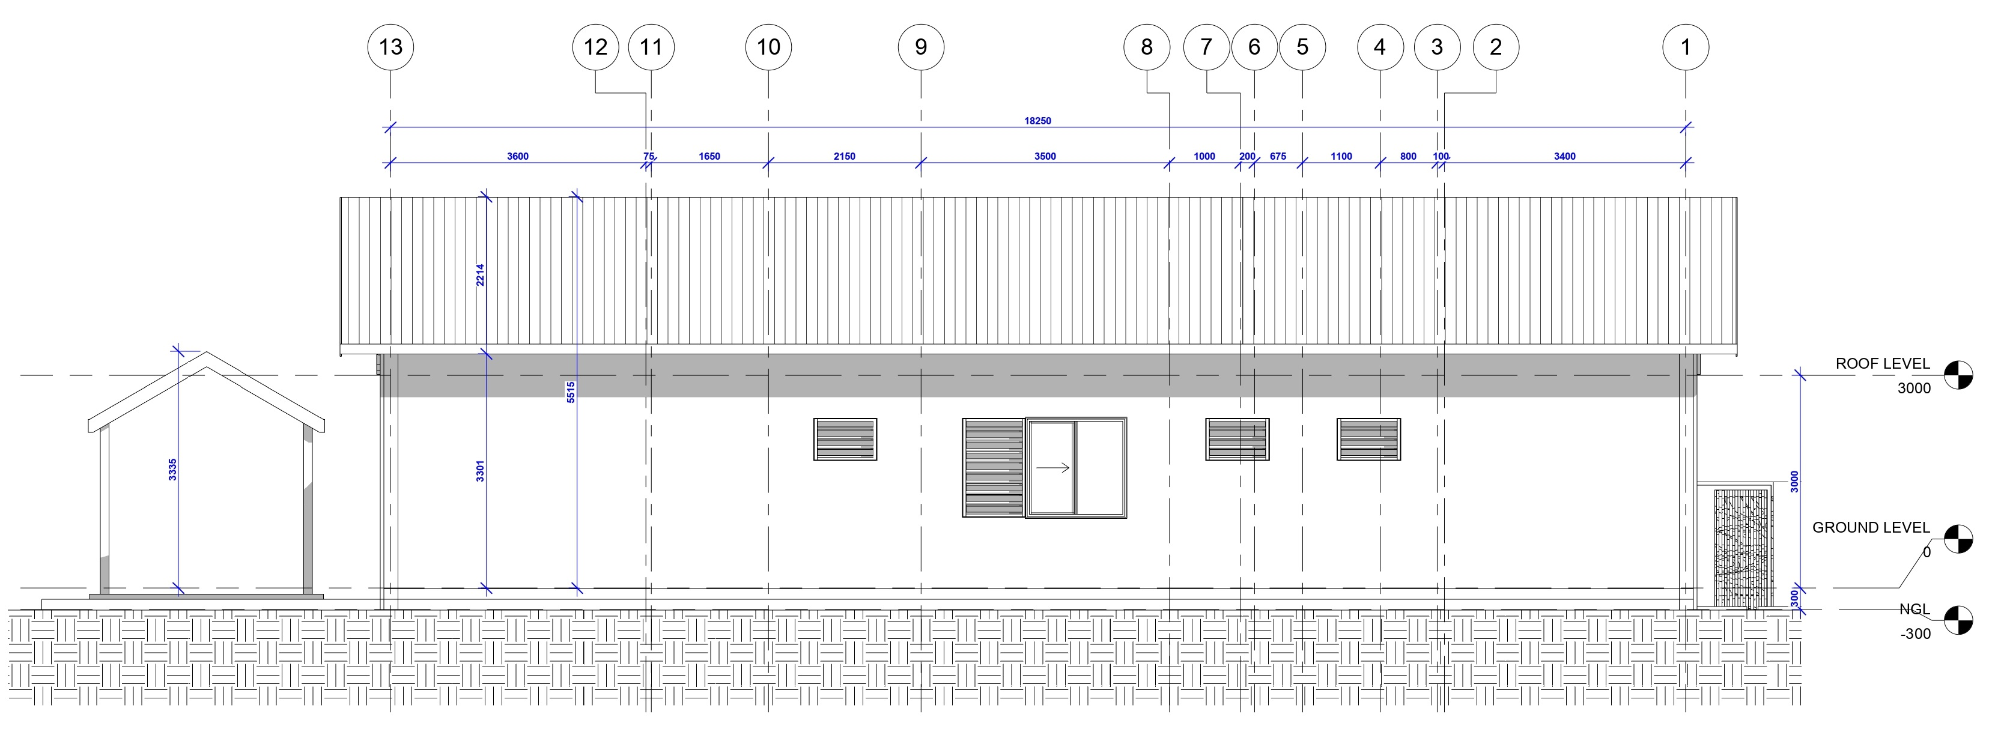
ELEVATION

Slide 17
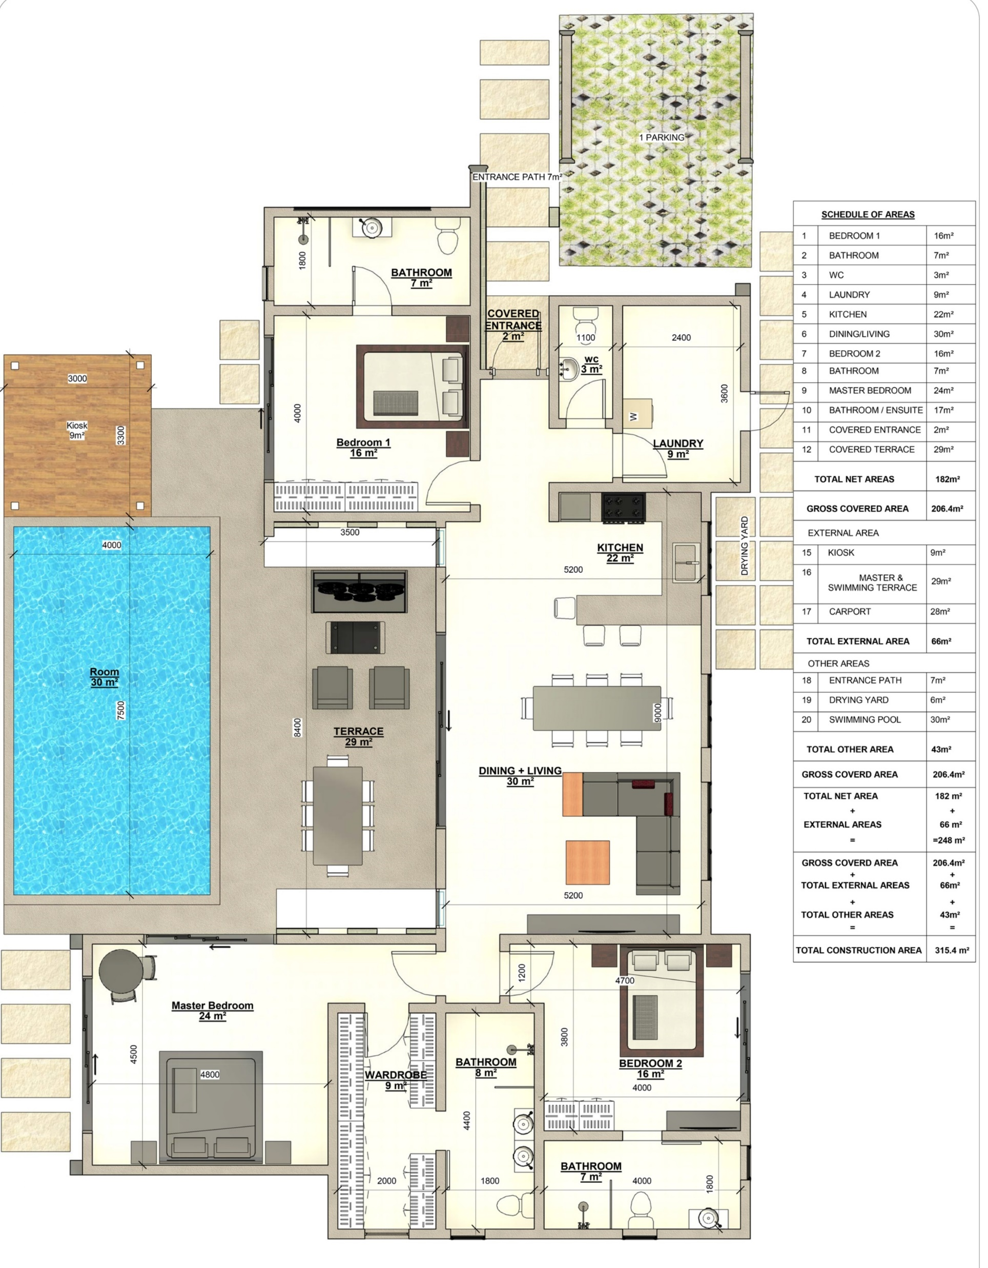
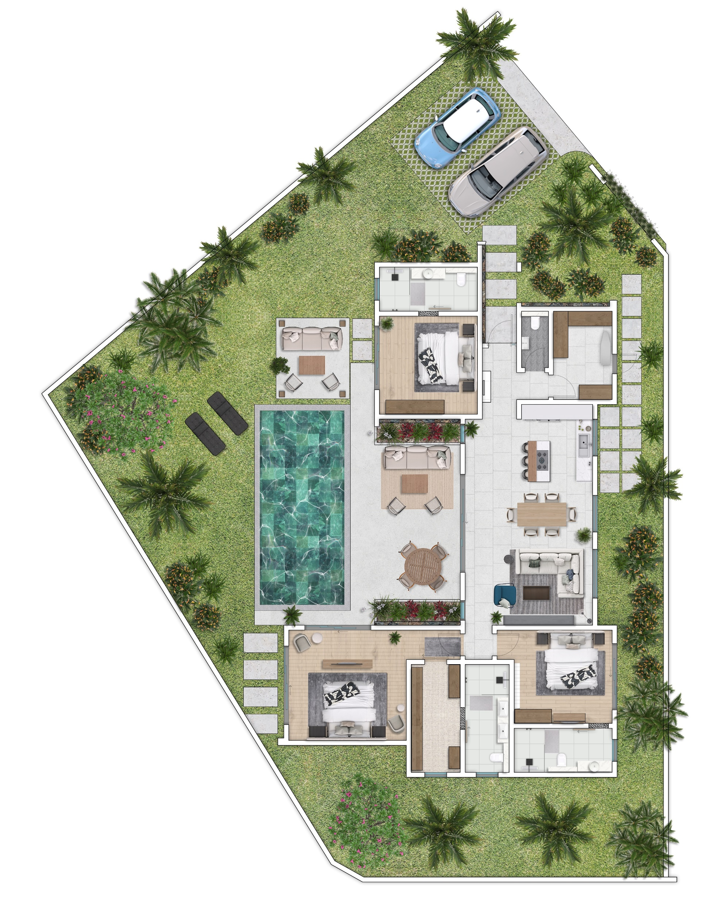
PLAN - VILLA SIGNATURE ( 1 Unit)

Slide 18
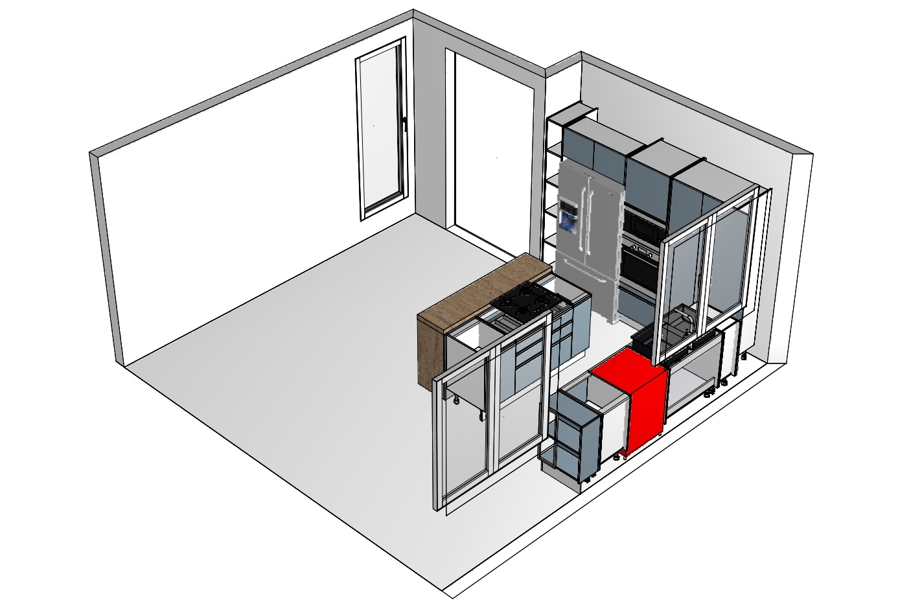
KITCHEN PLAN

Slide 19
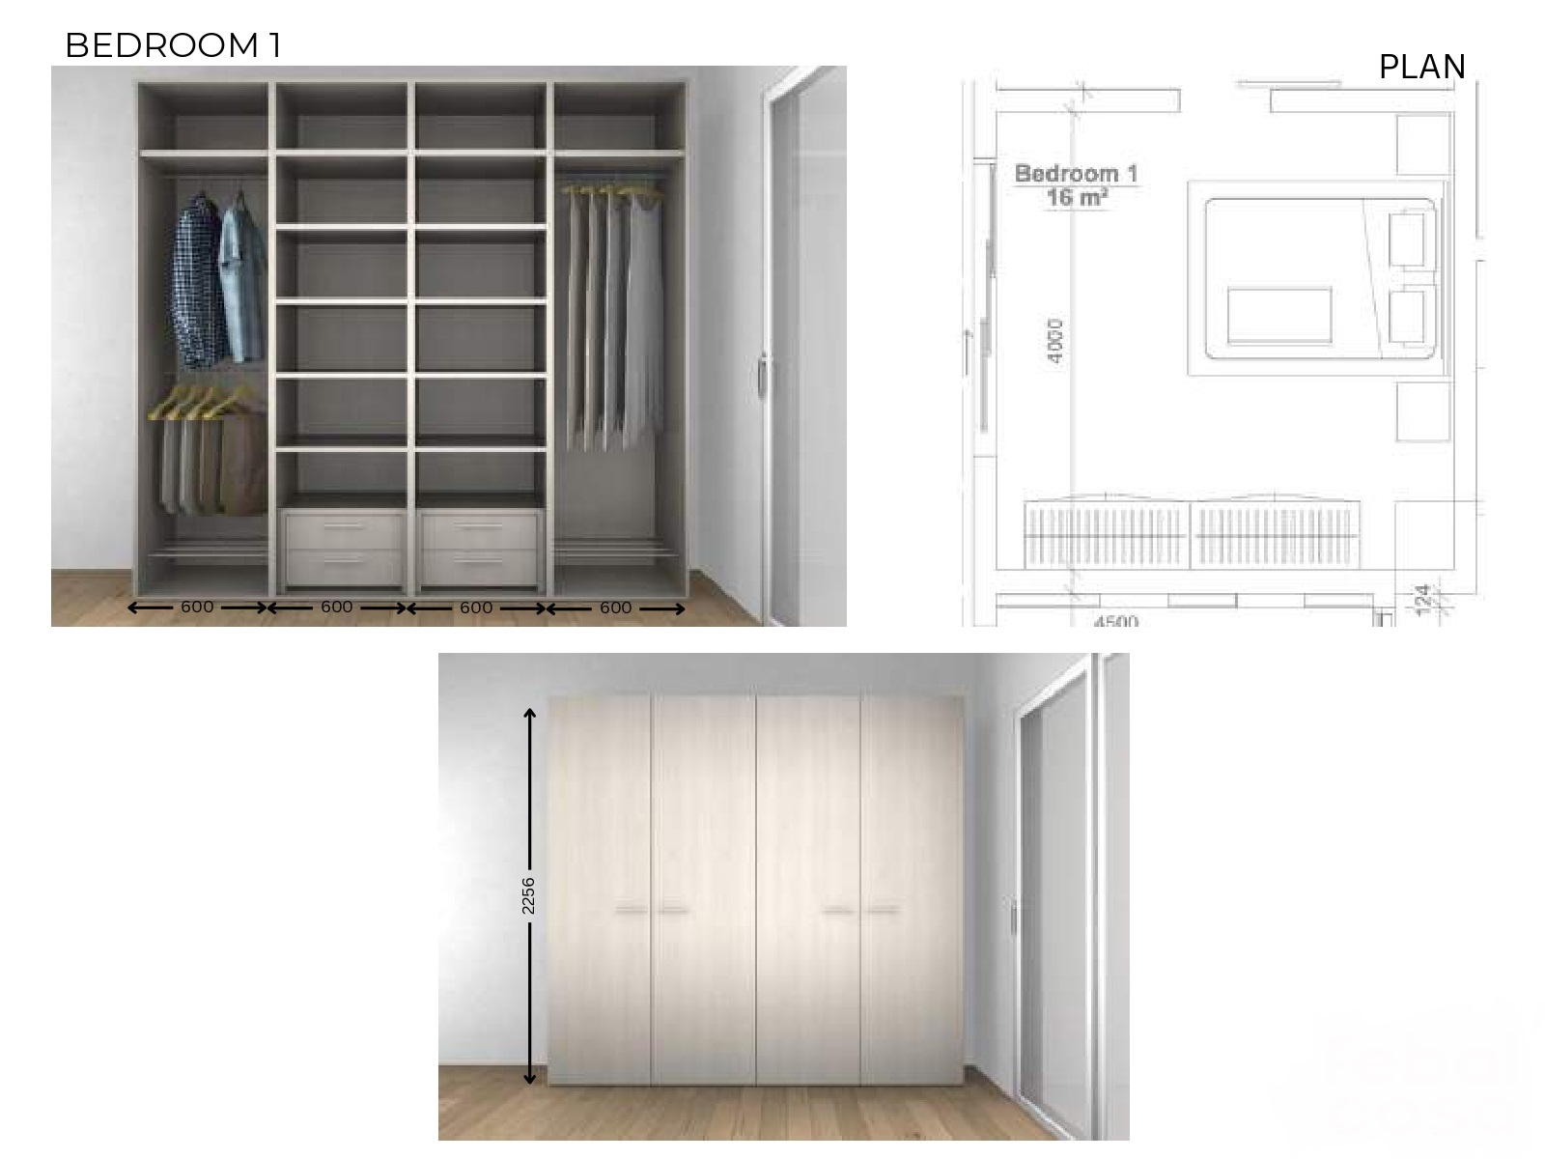
BEDROOM 01- DRESSING

Slide 20
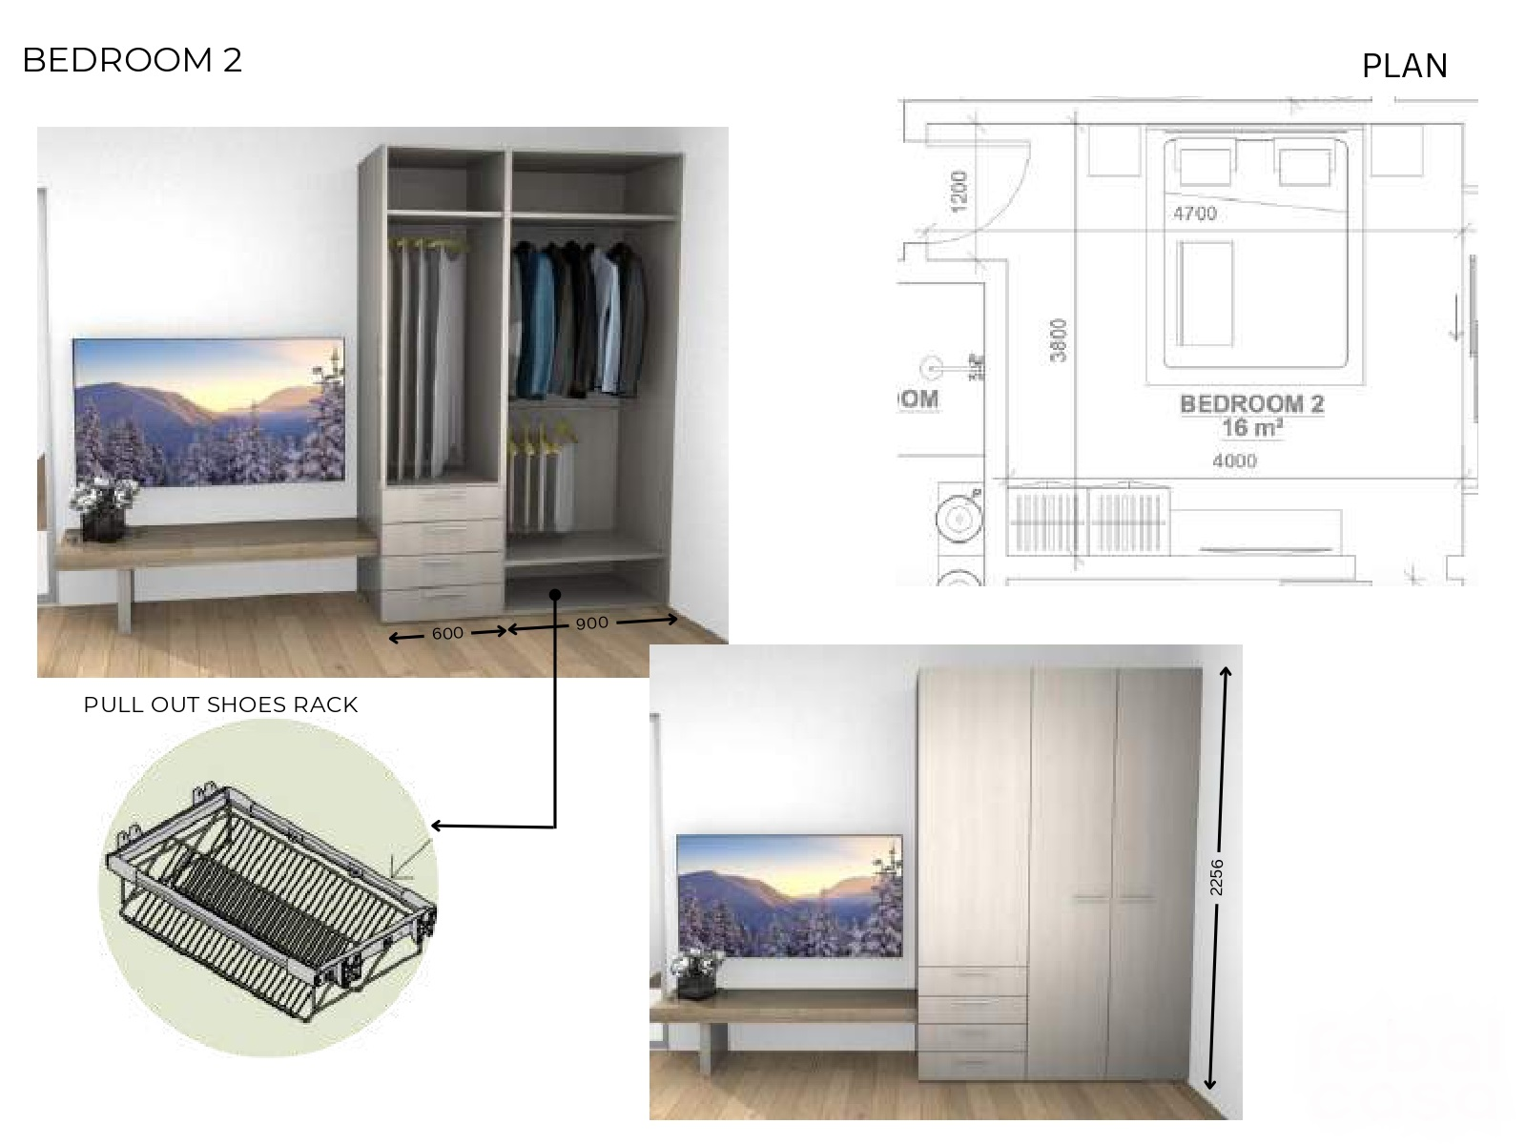

Slide 21
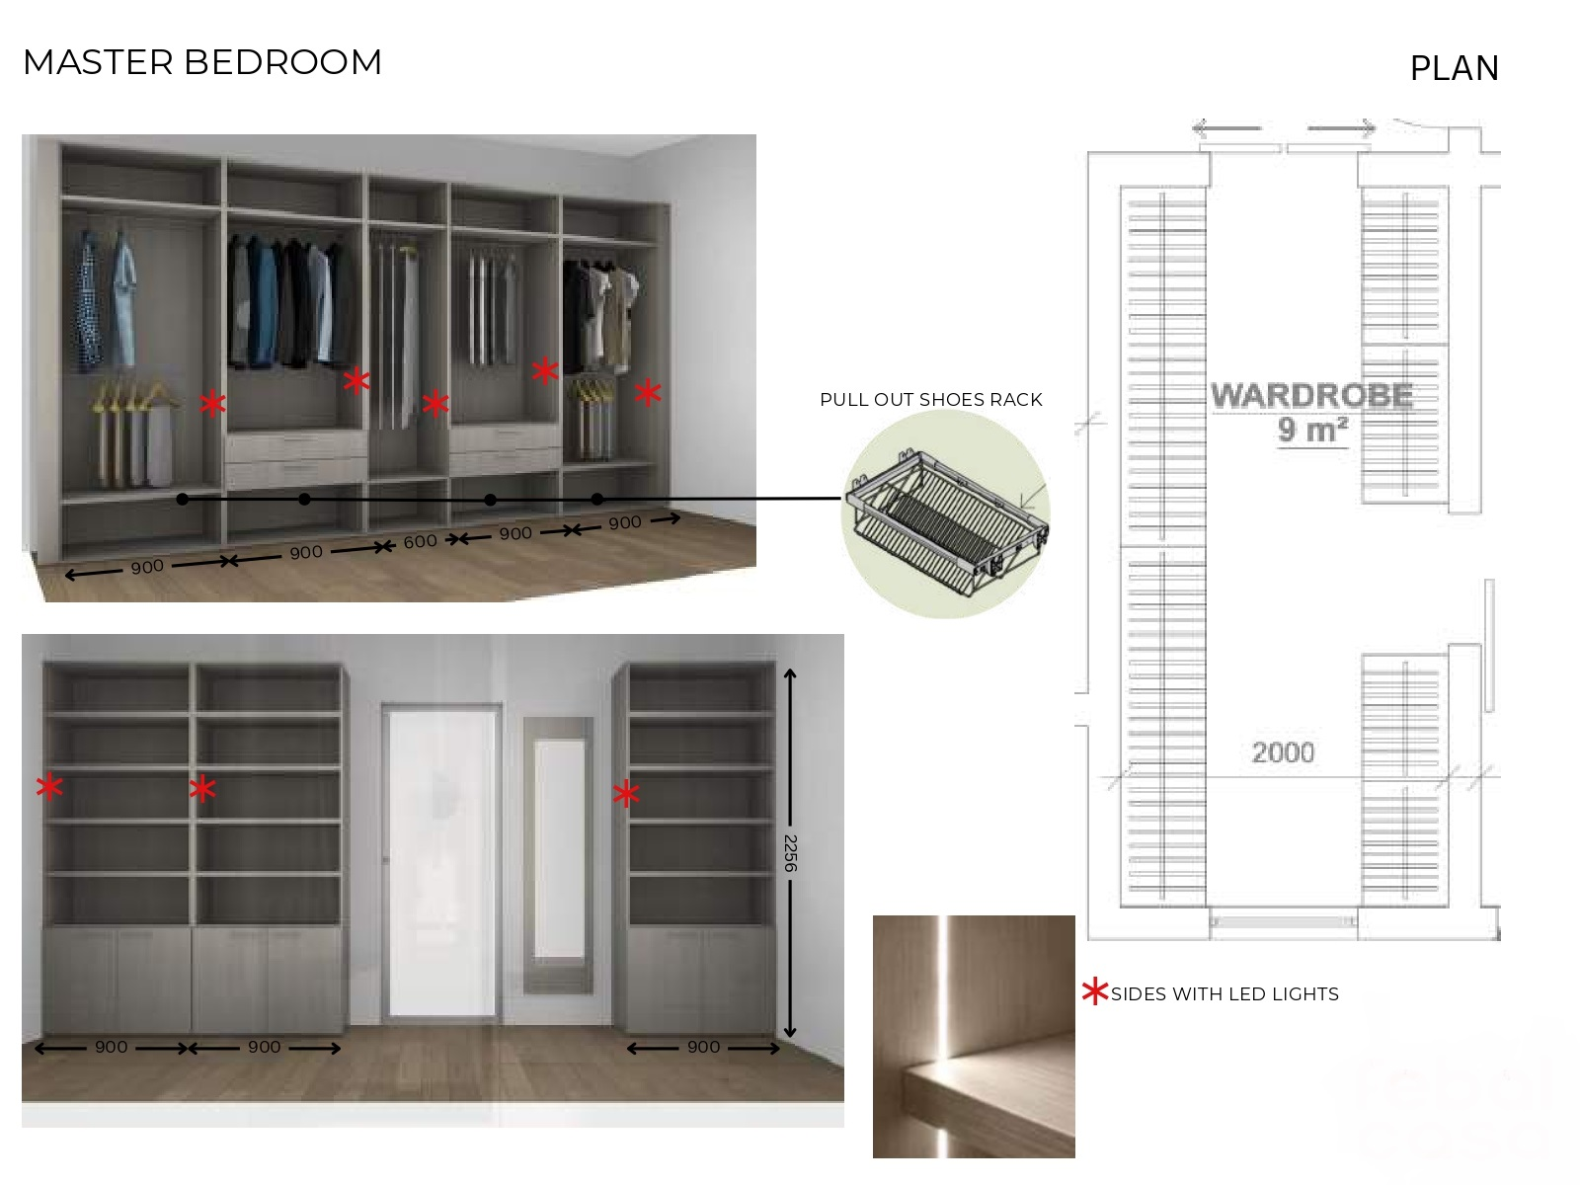

Slide 22
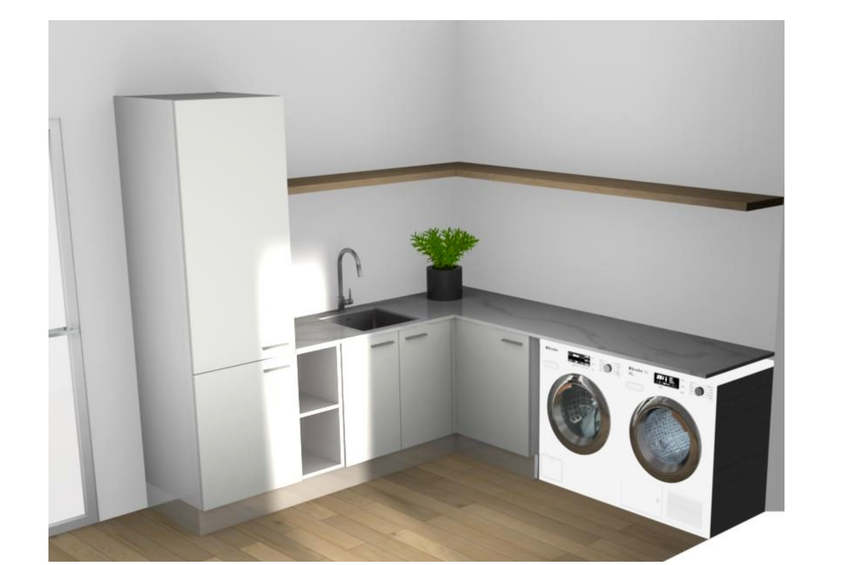

Slide 23
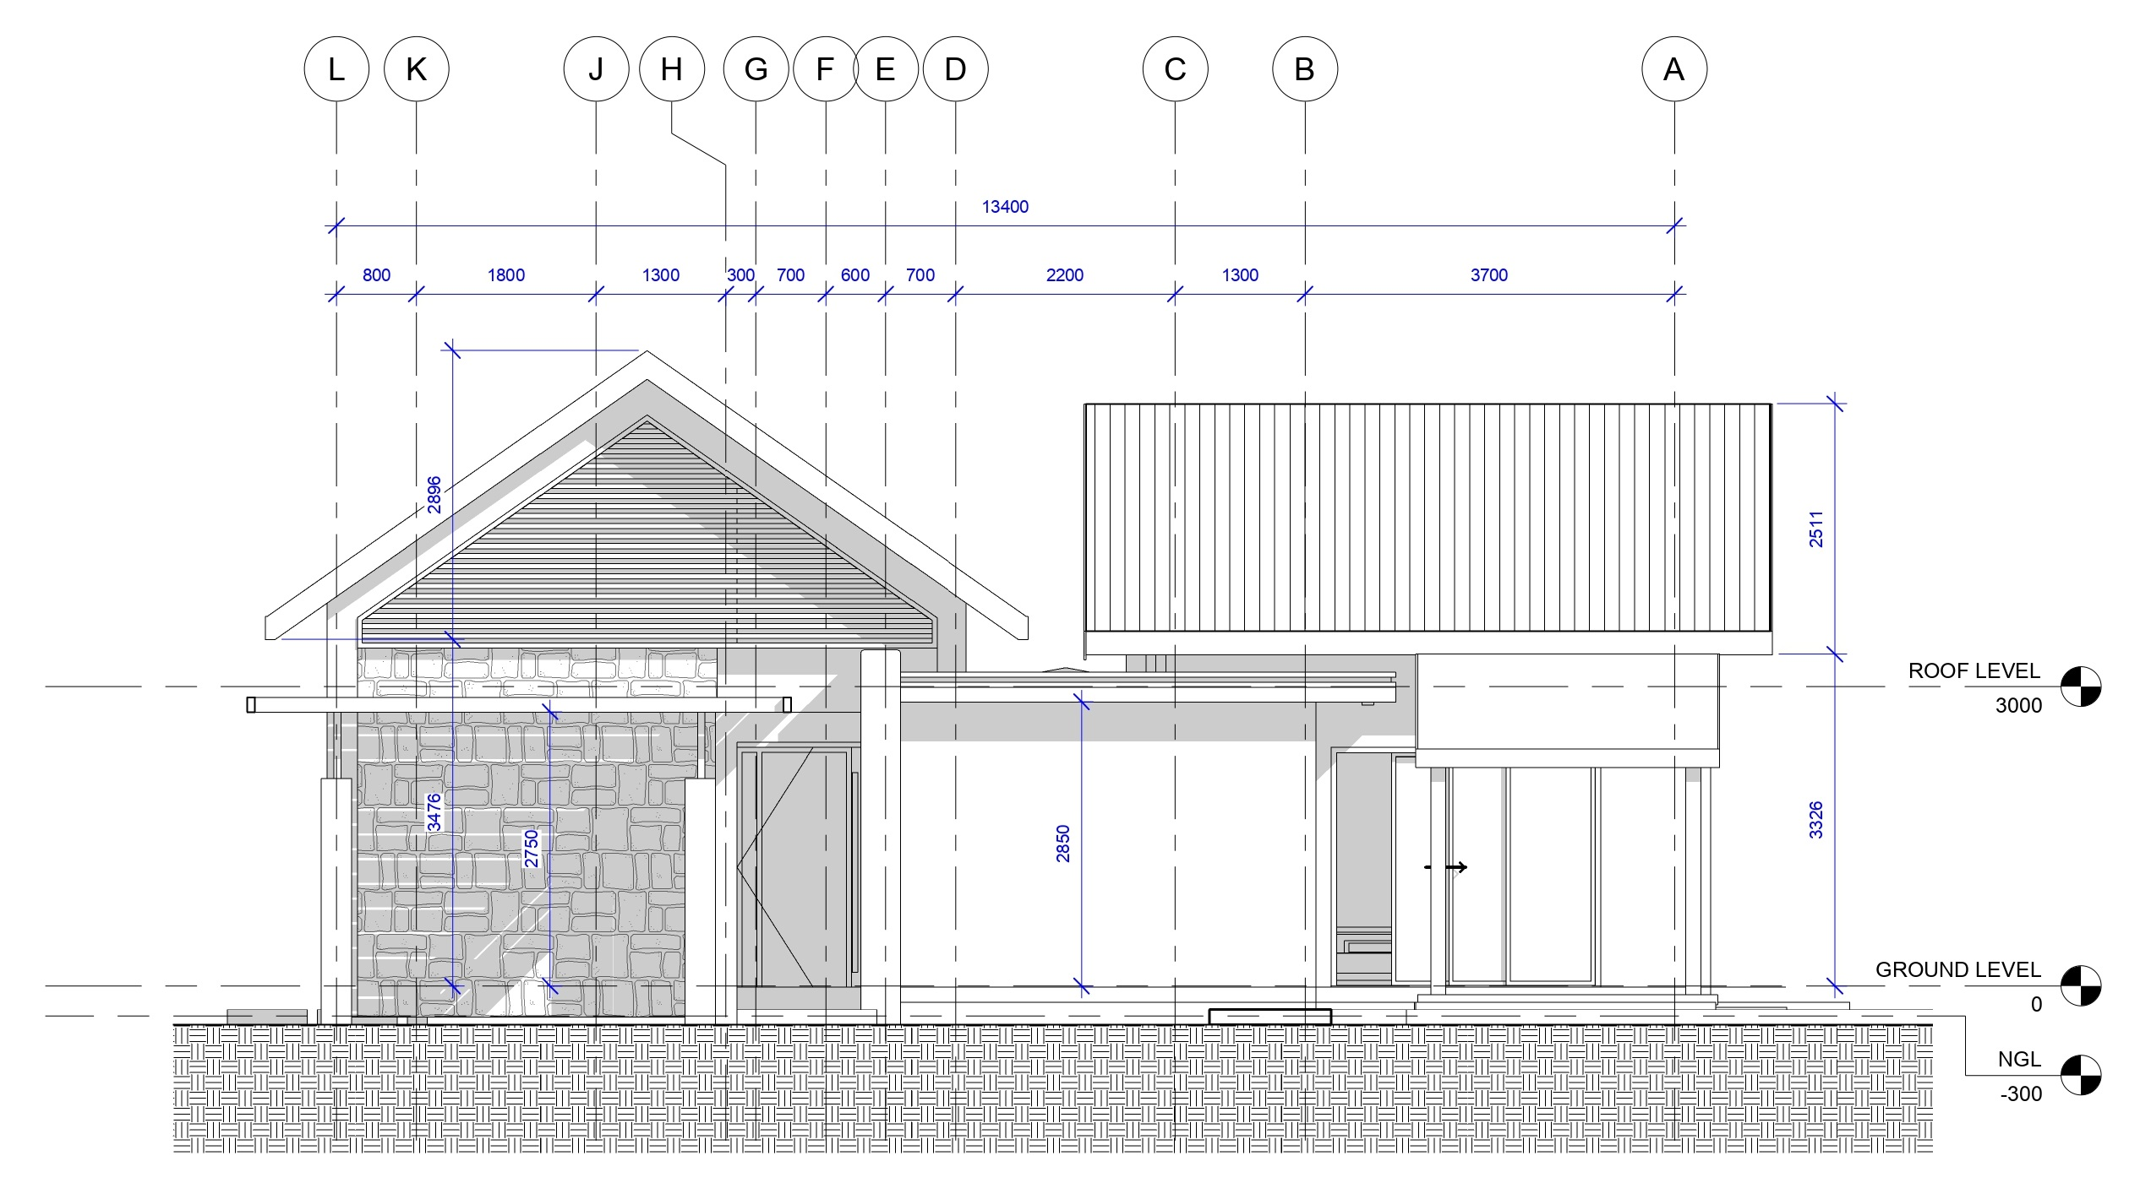
ELEVATION

Slide 24
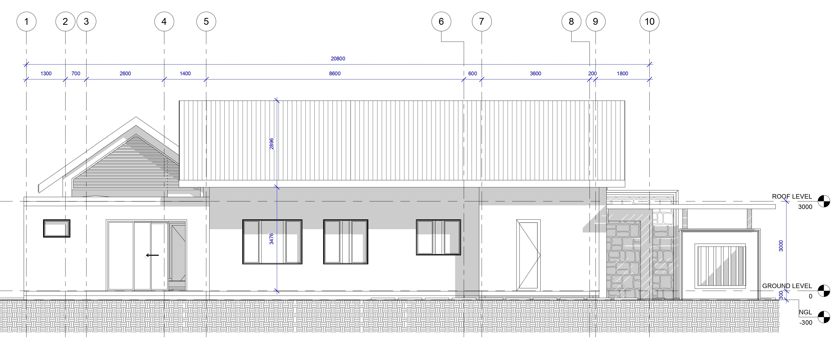
ELEVATION

Slide 25
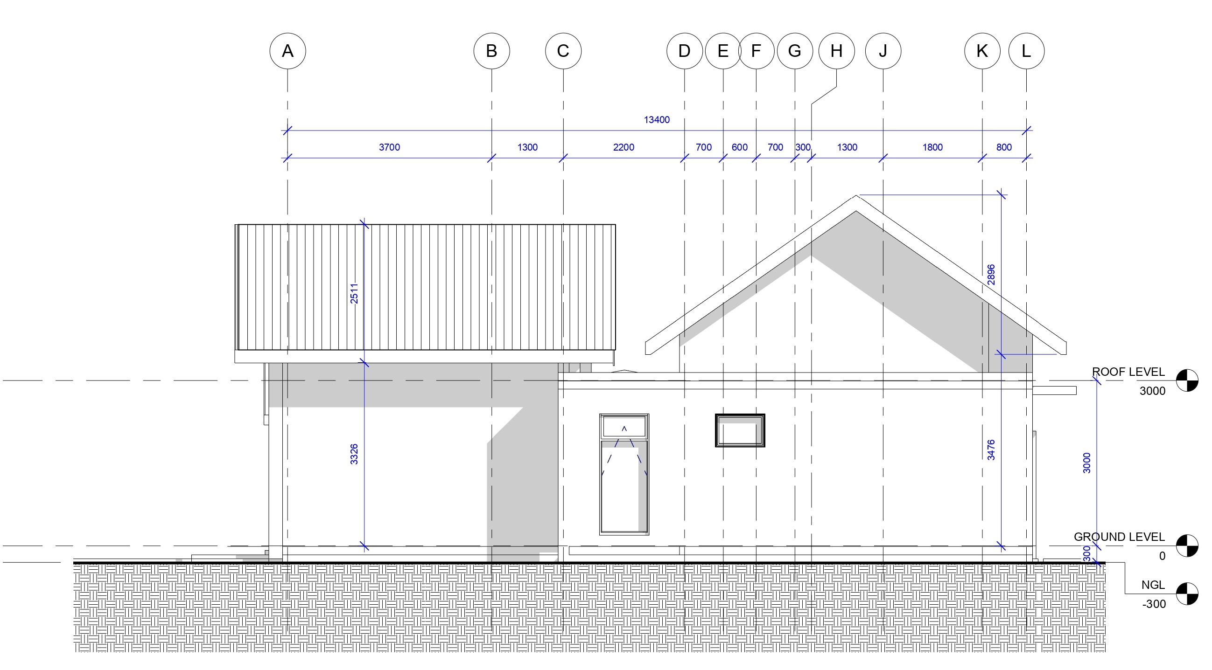
ELEVATION

Slide 26
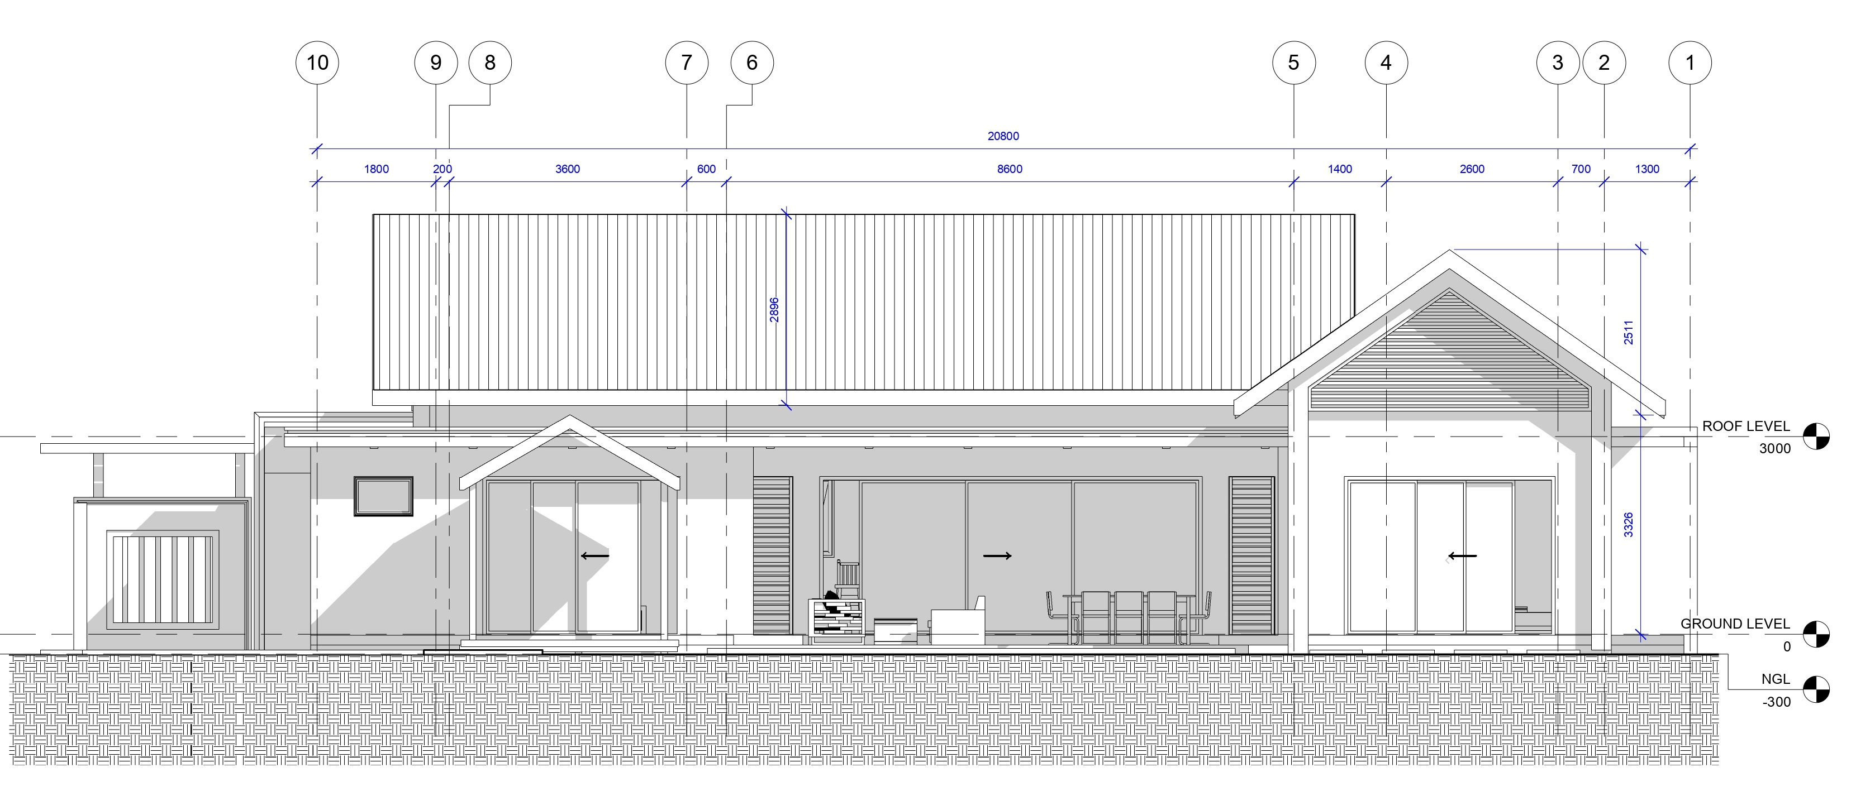
ELEVATION

Slide 27
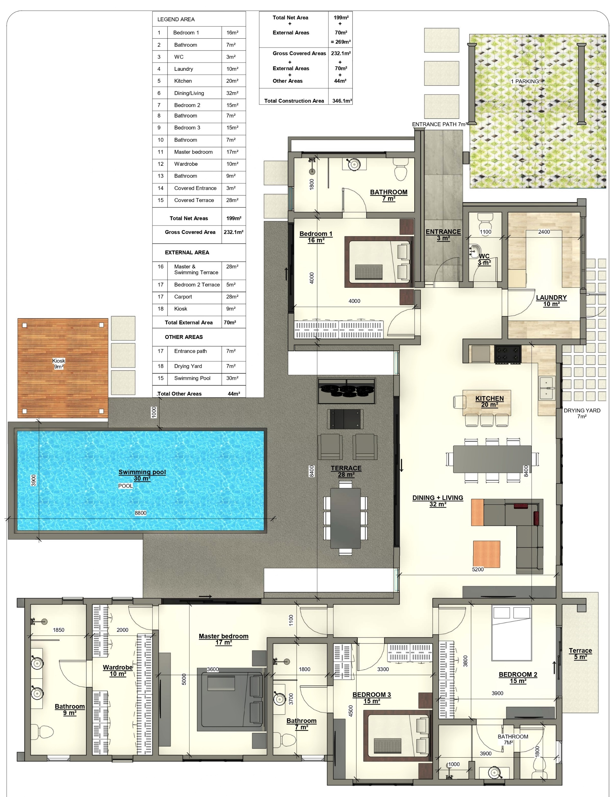
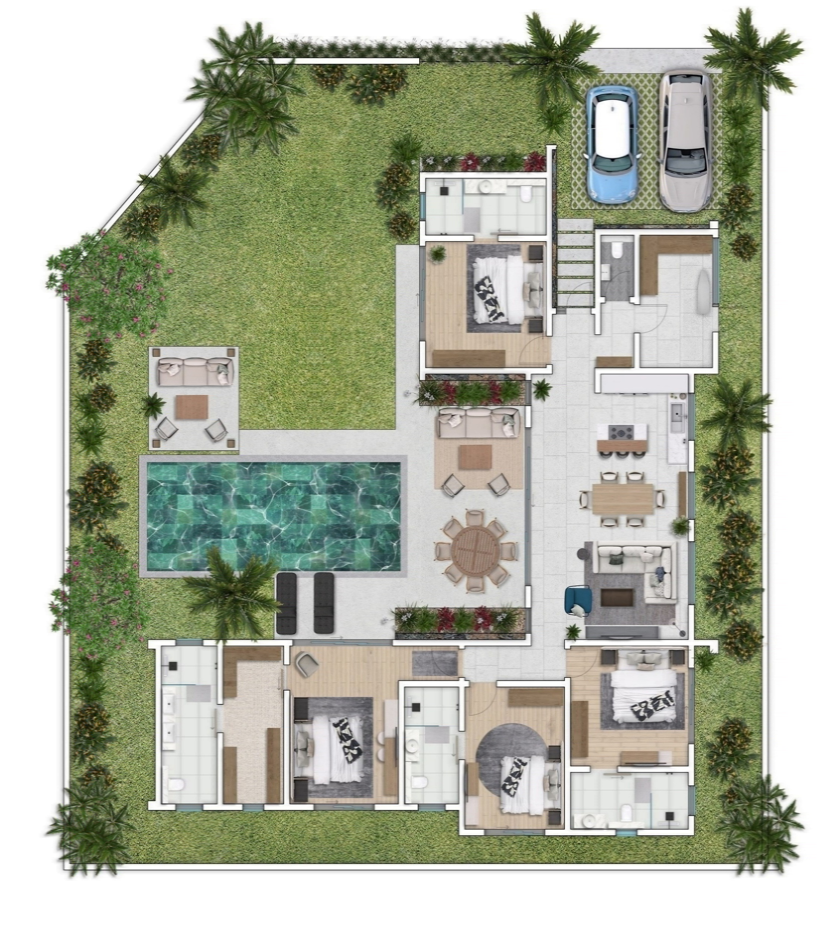
Plan – Villa Exclusive ( 4 Units)

Slide 28
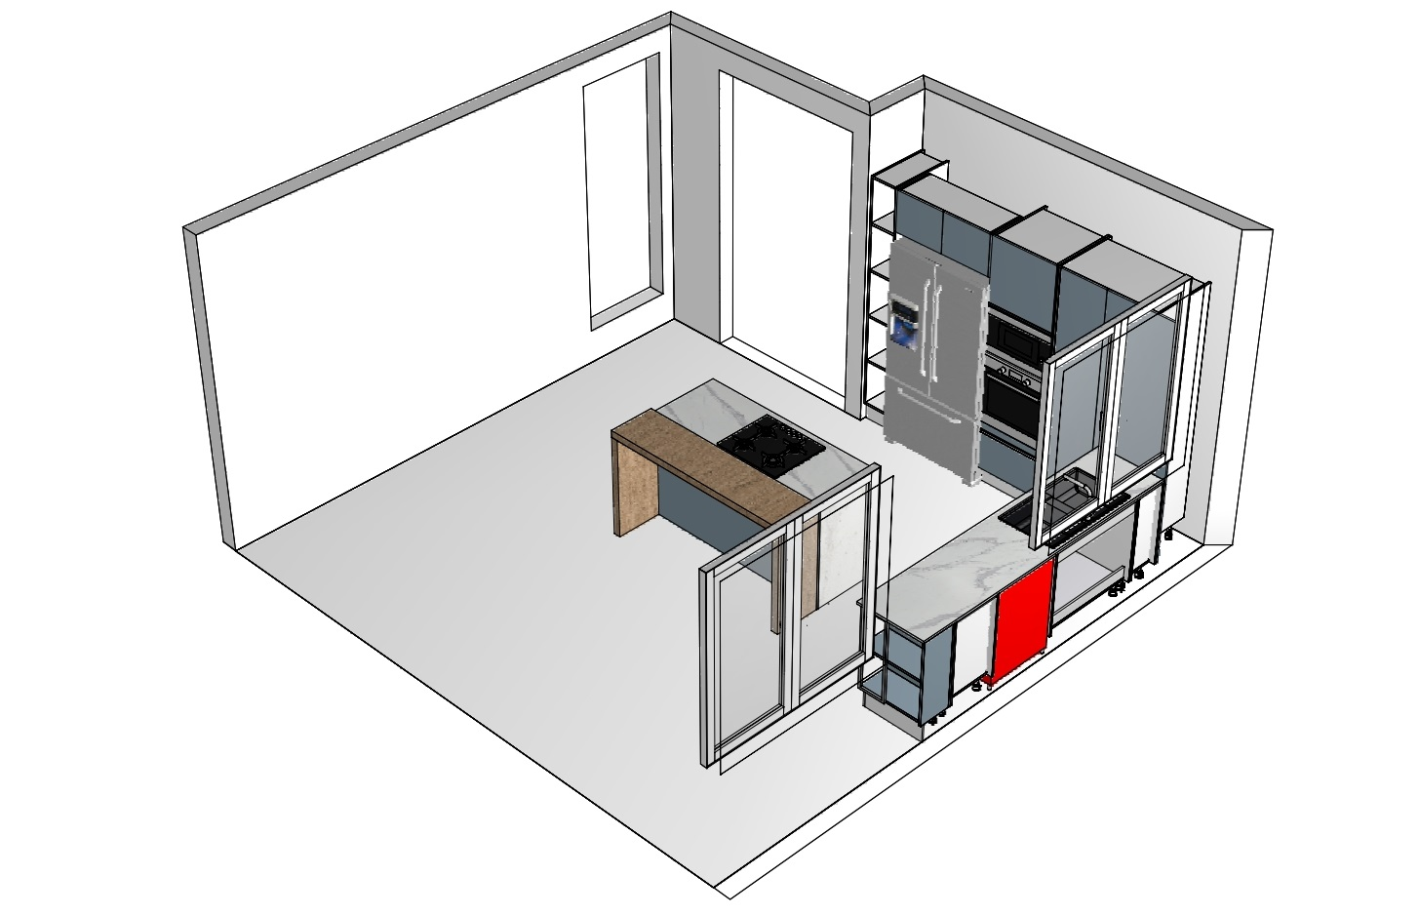
KITCHEN PLAN

Slide 29
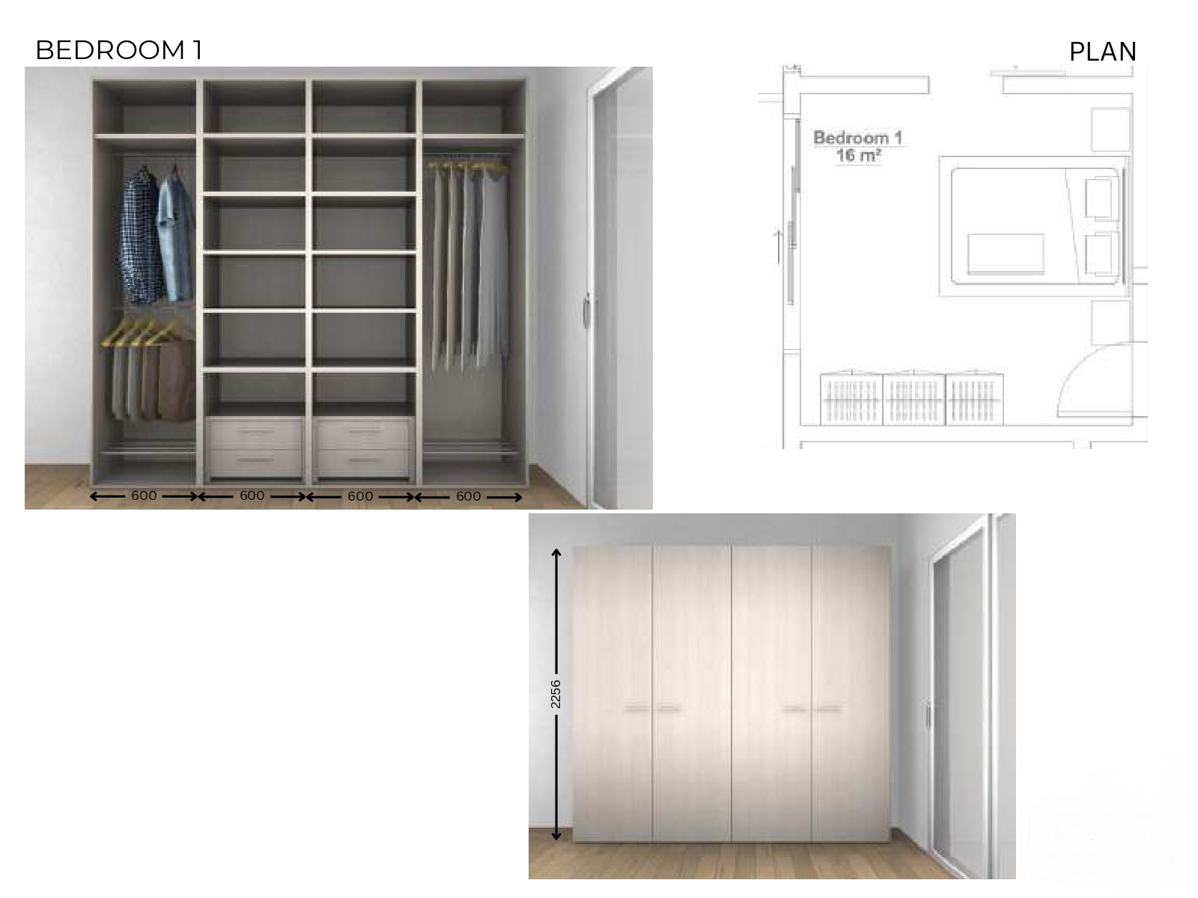
BEDROOM 01 – DRESSING

Slide 30
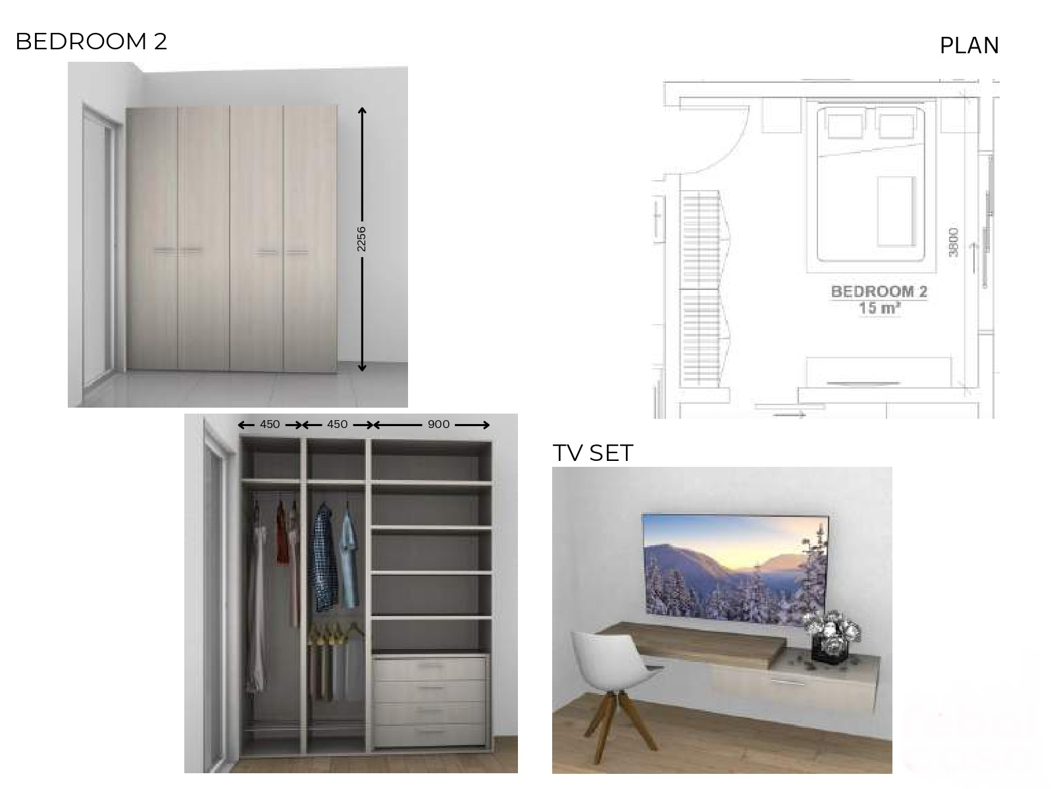

Slide 31
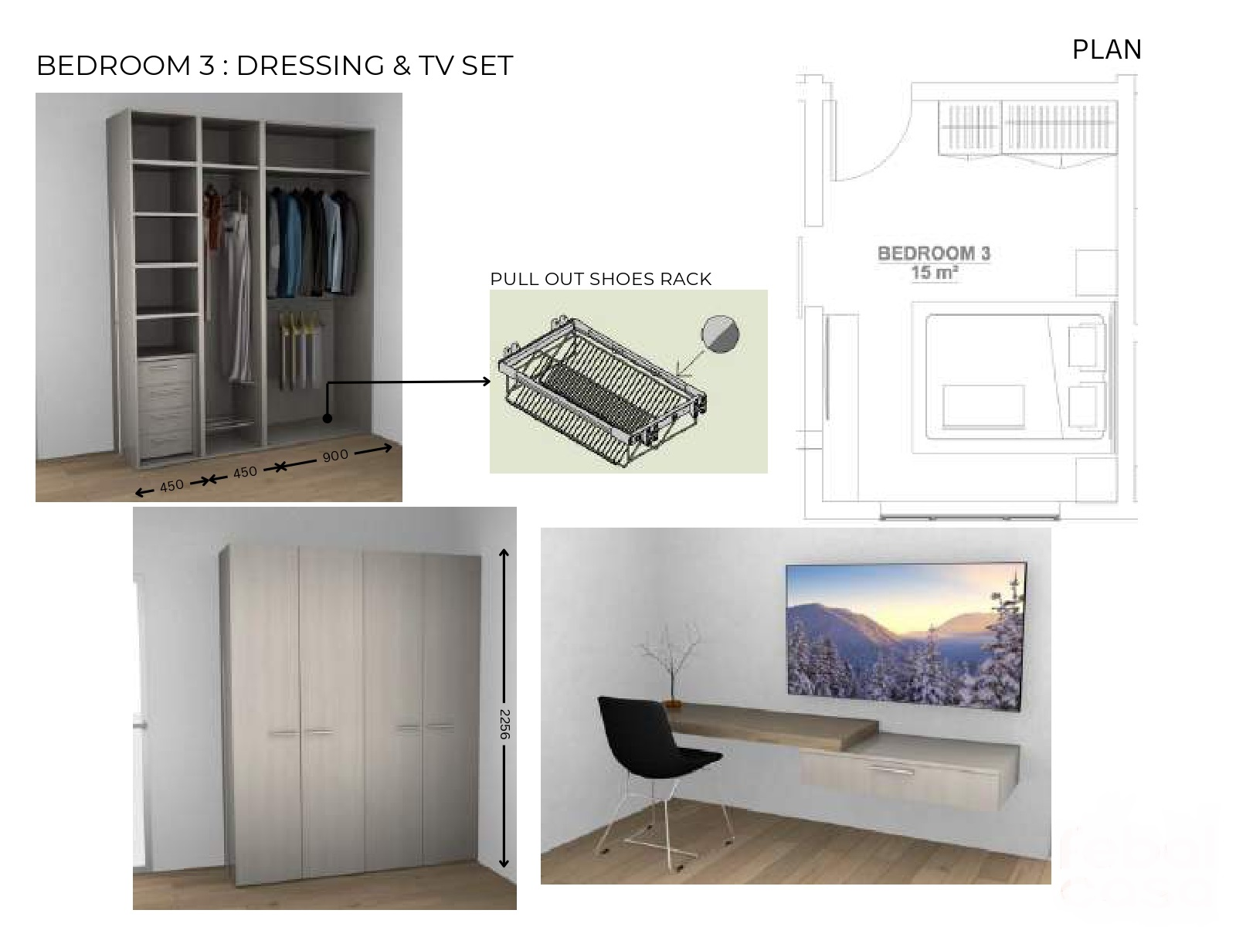

Slide 32
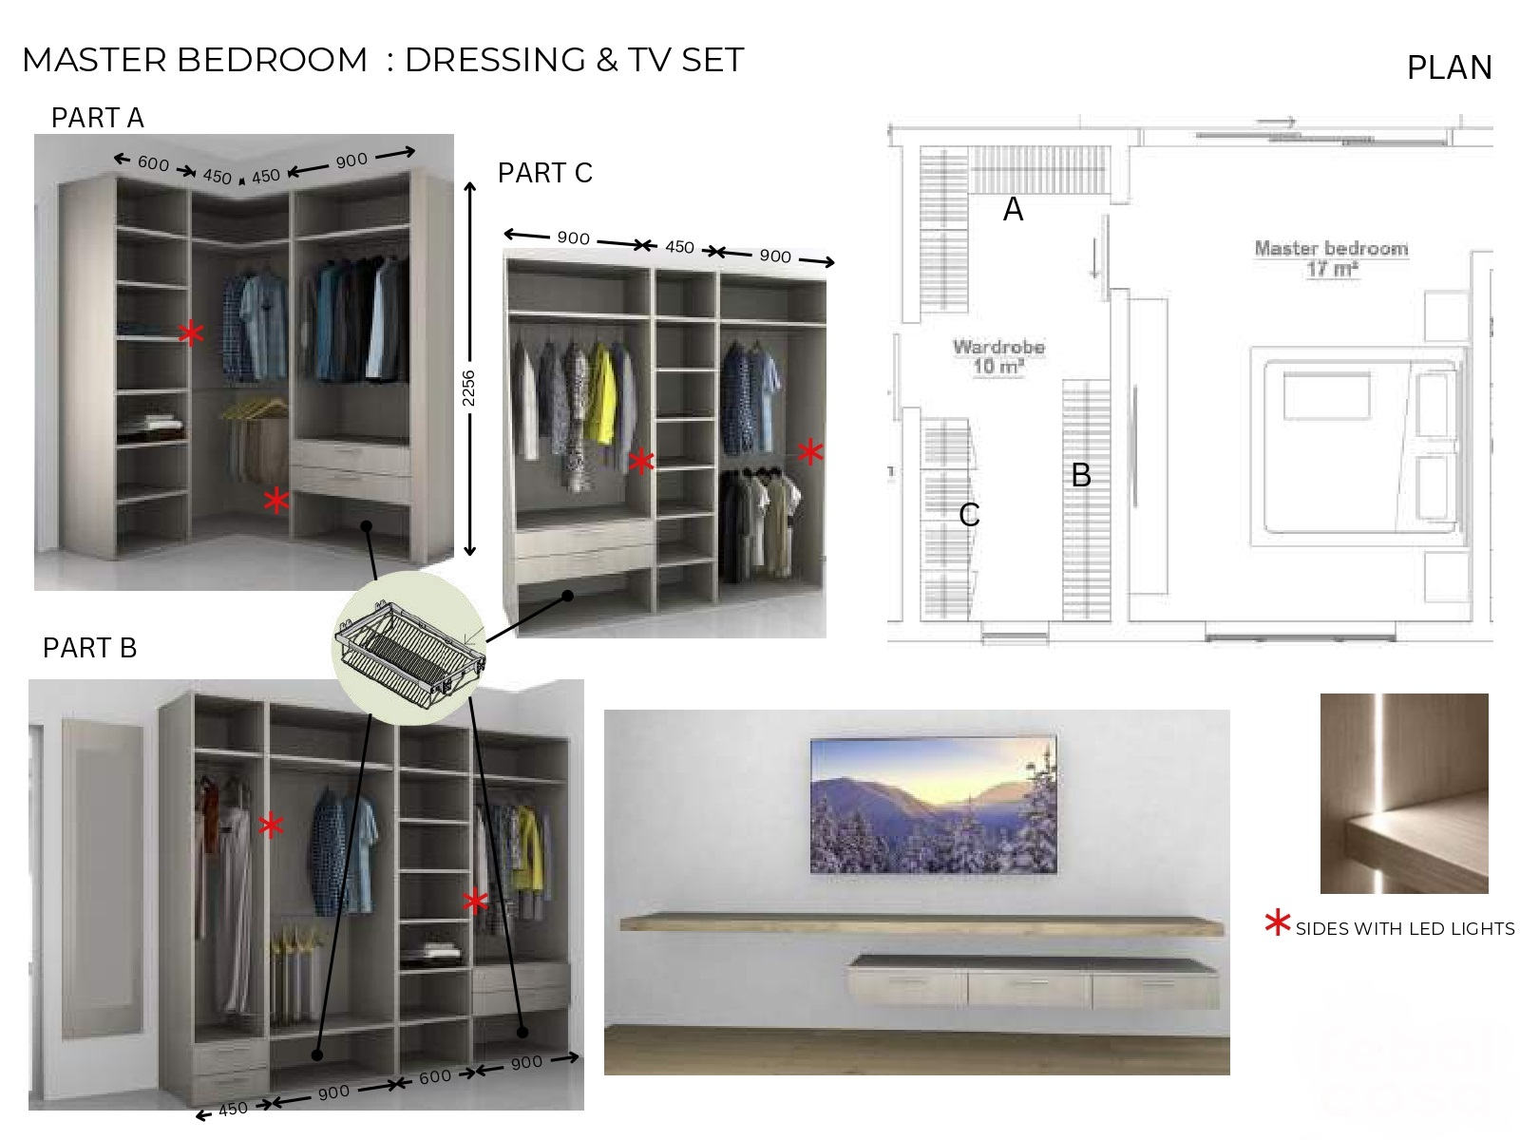

Slide 33
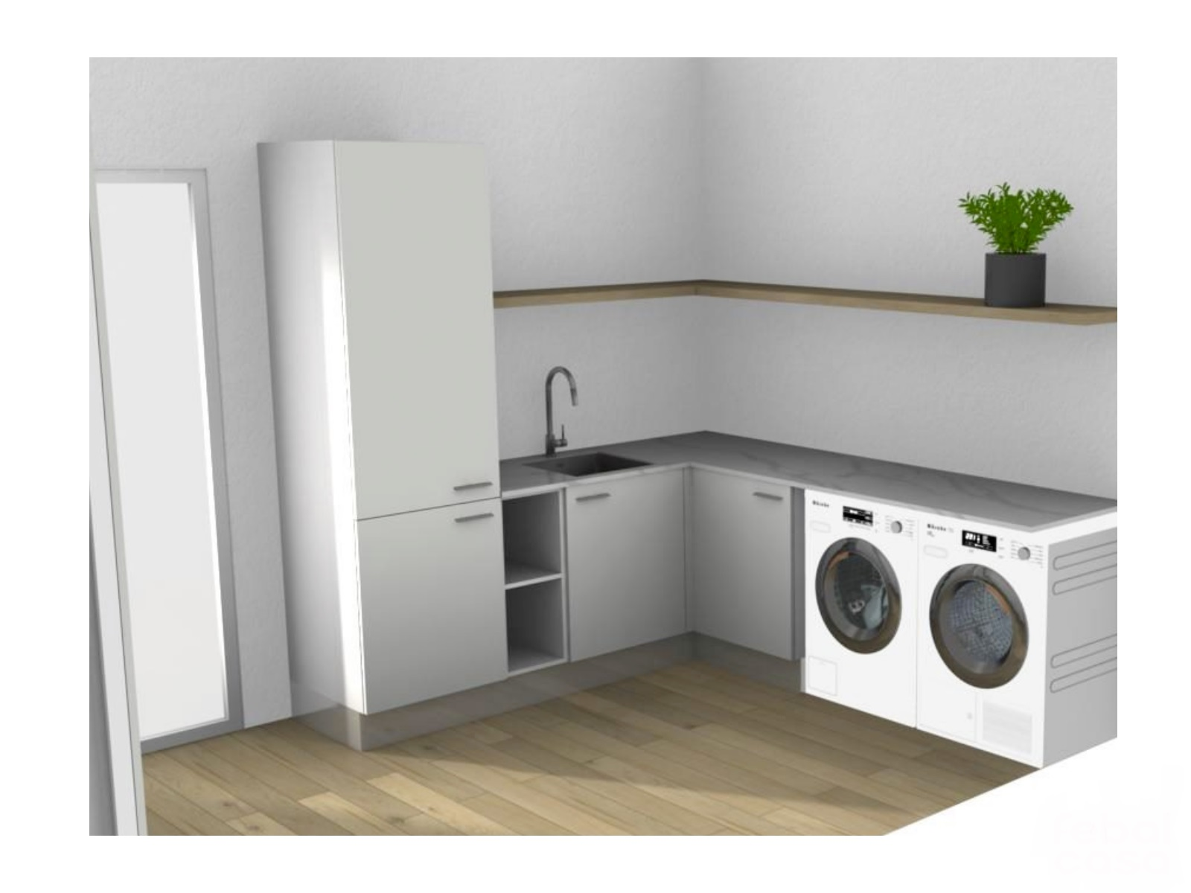

Slide 34
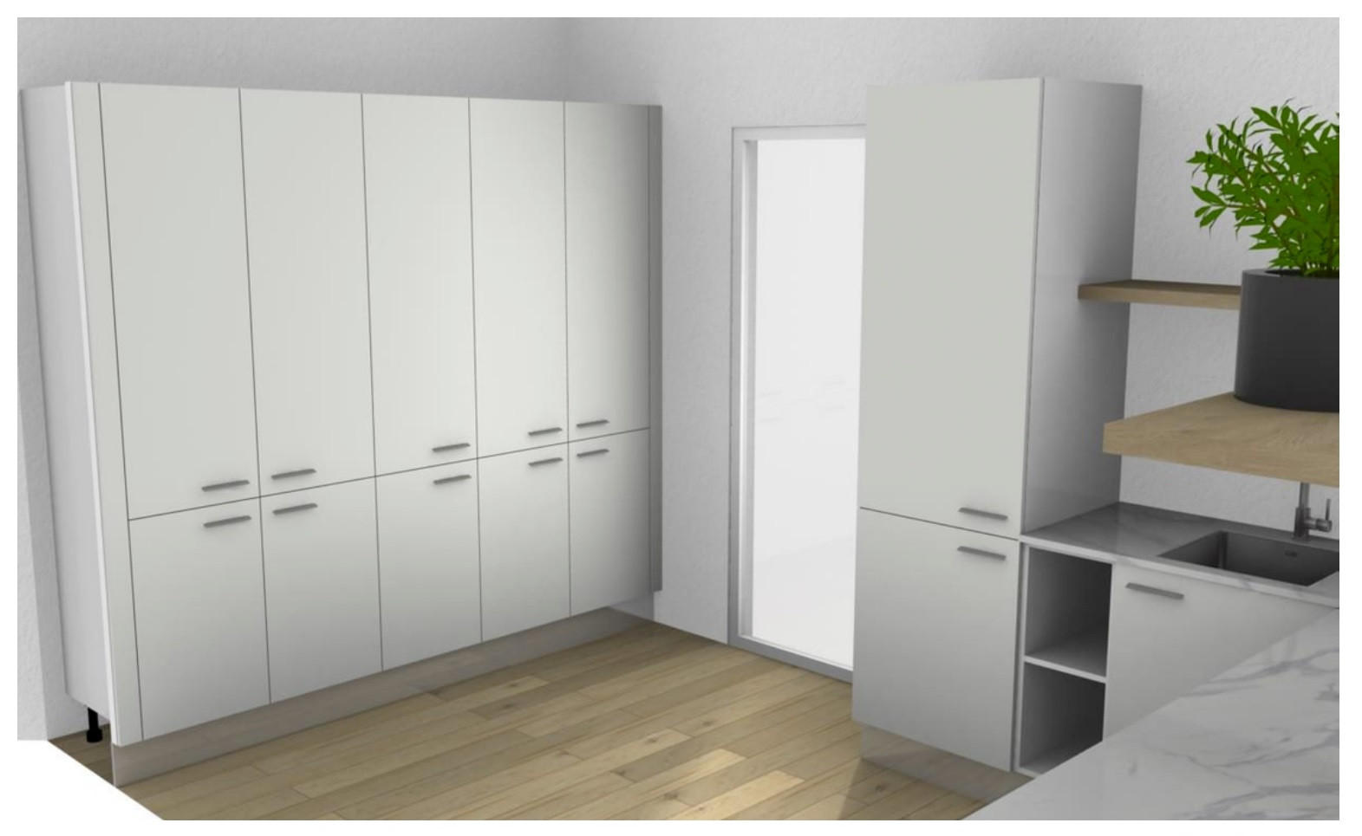

Slide 35
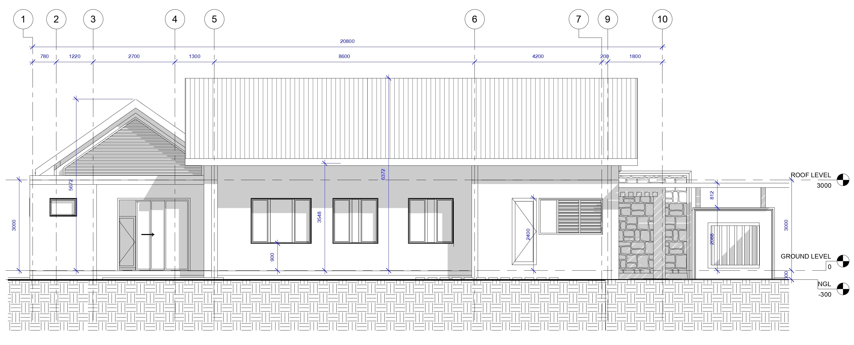
ELEVATION

Slide 36
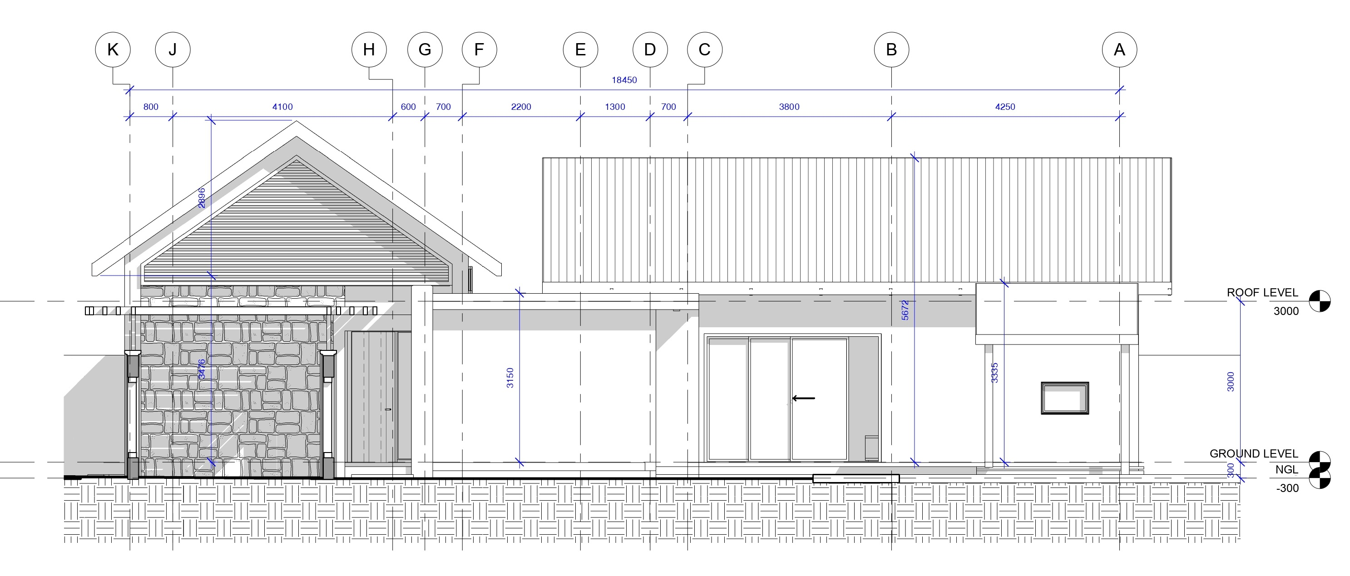
ELEVATION

Slide 37
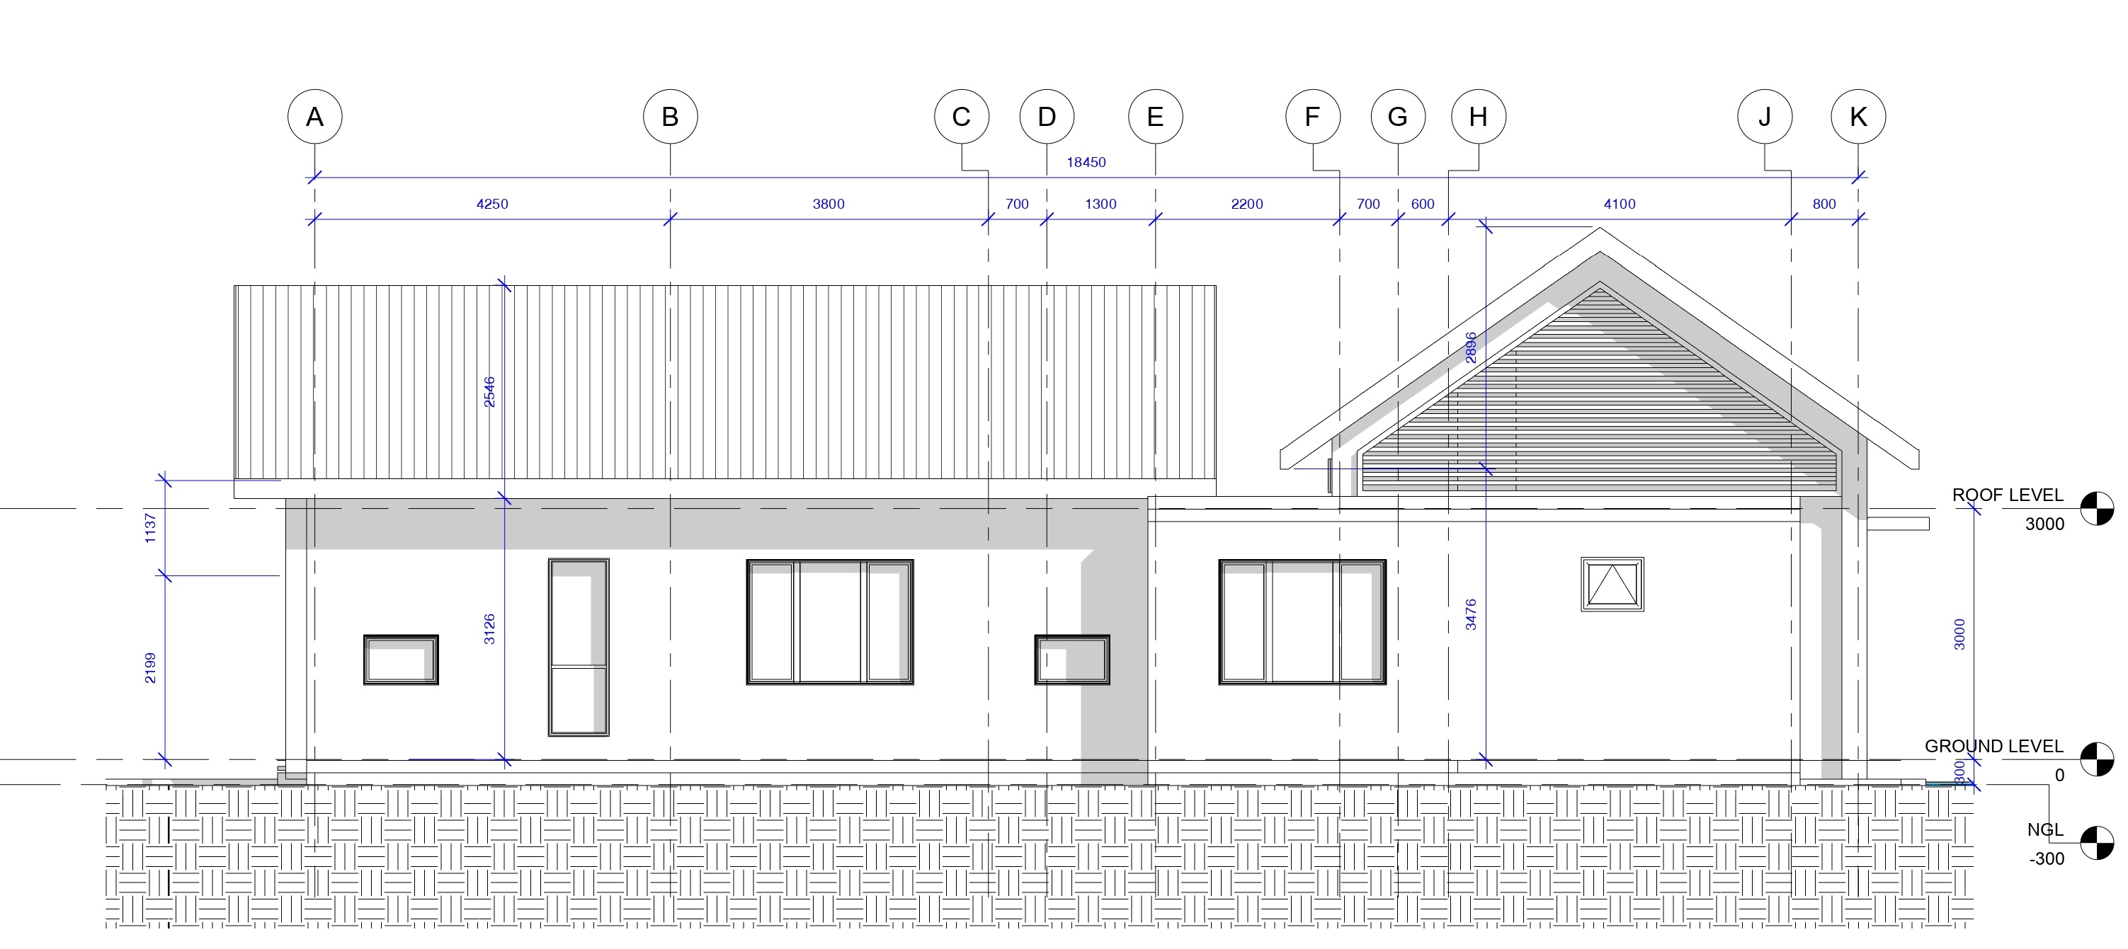
ELEVATION

Slide 38
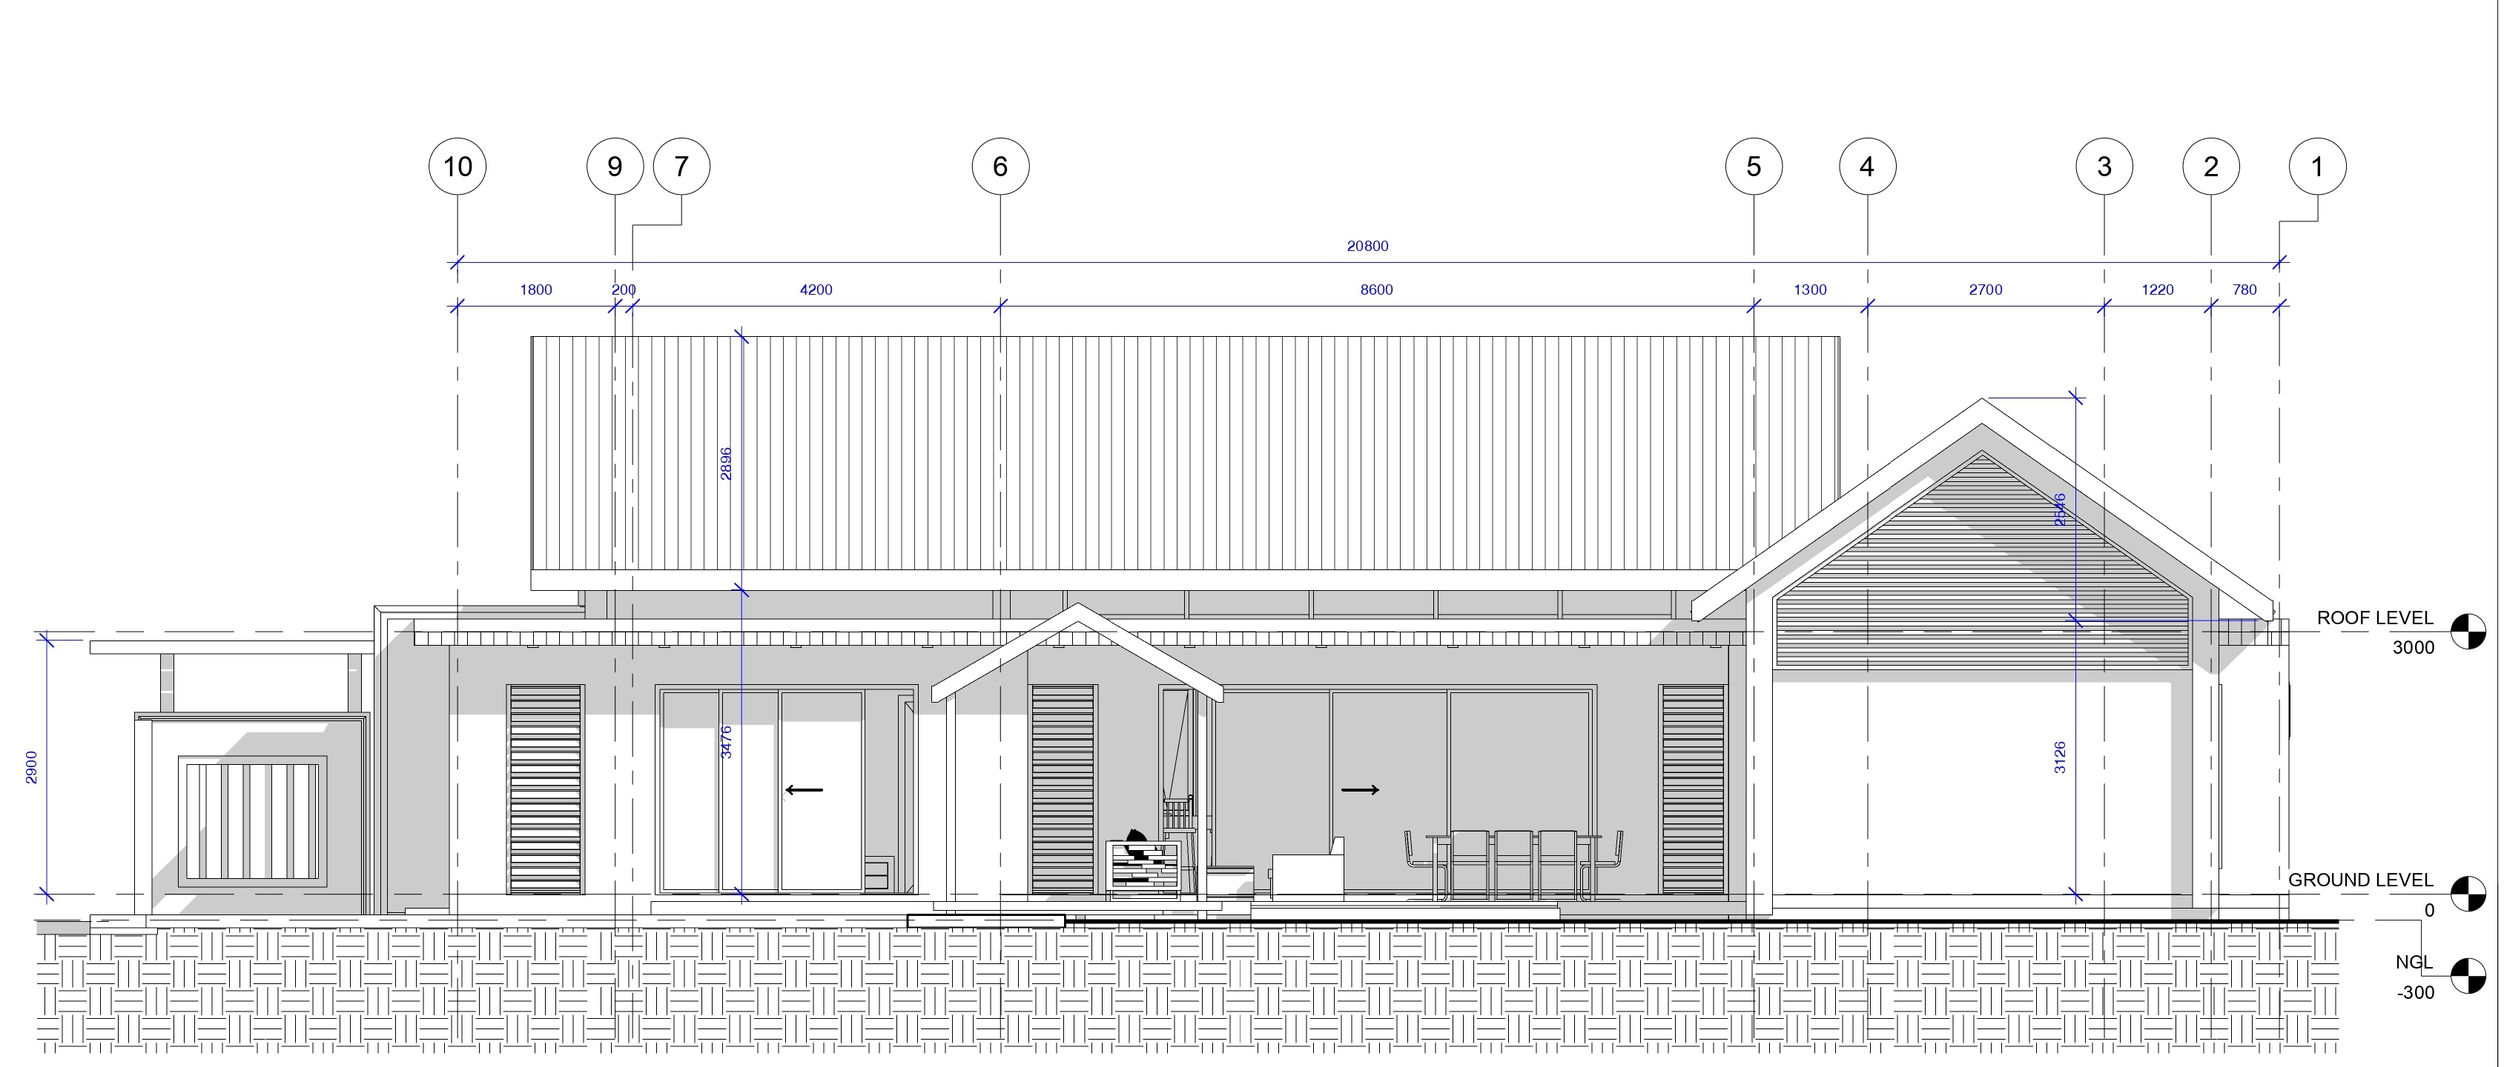
ELEVATION

Slide 40
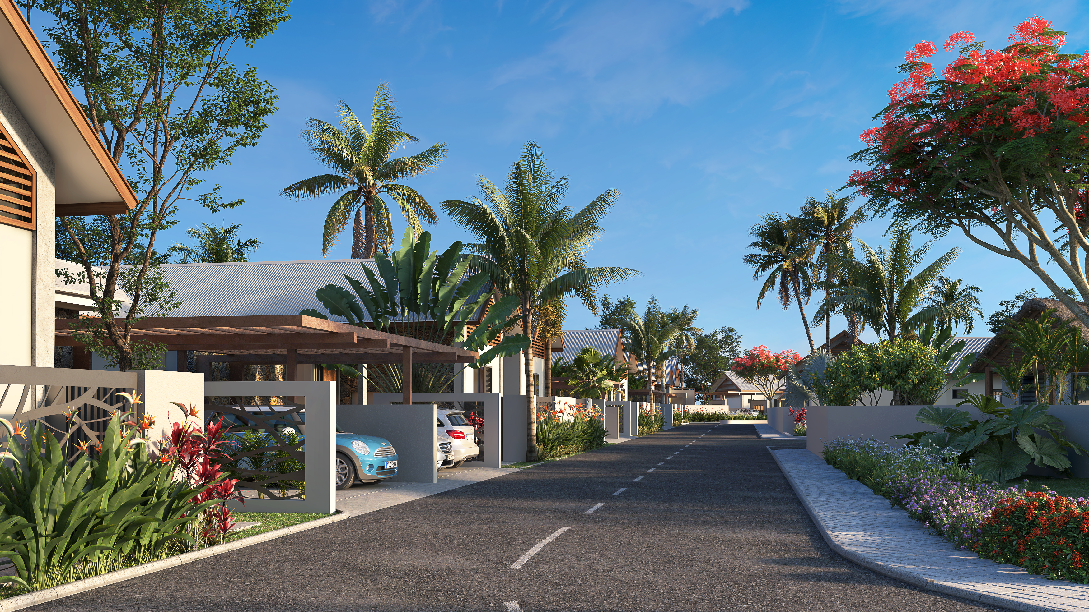

Slide 41
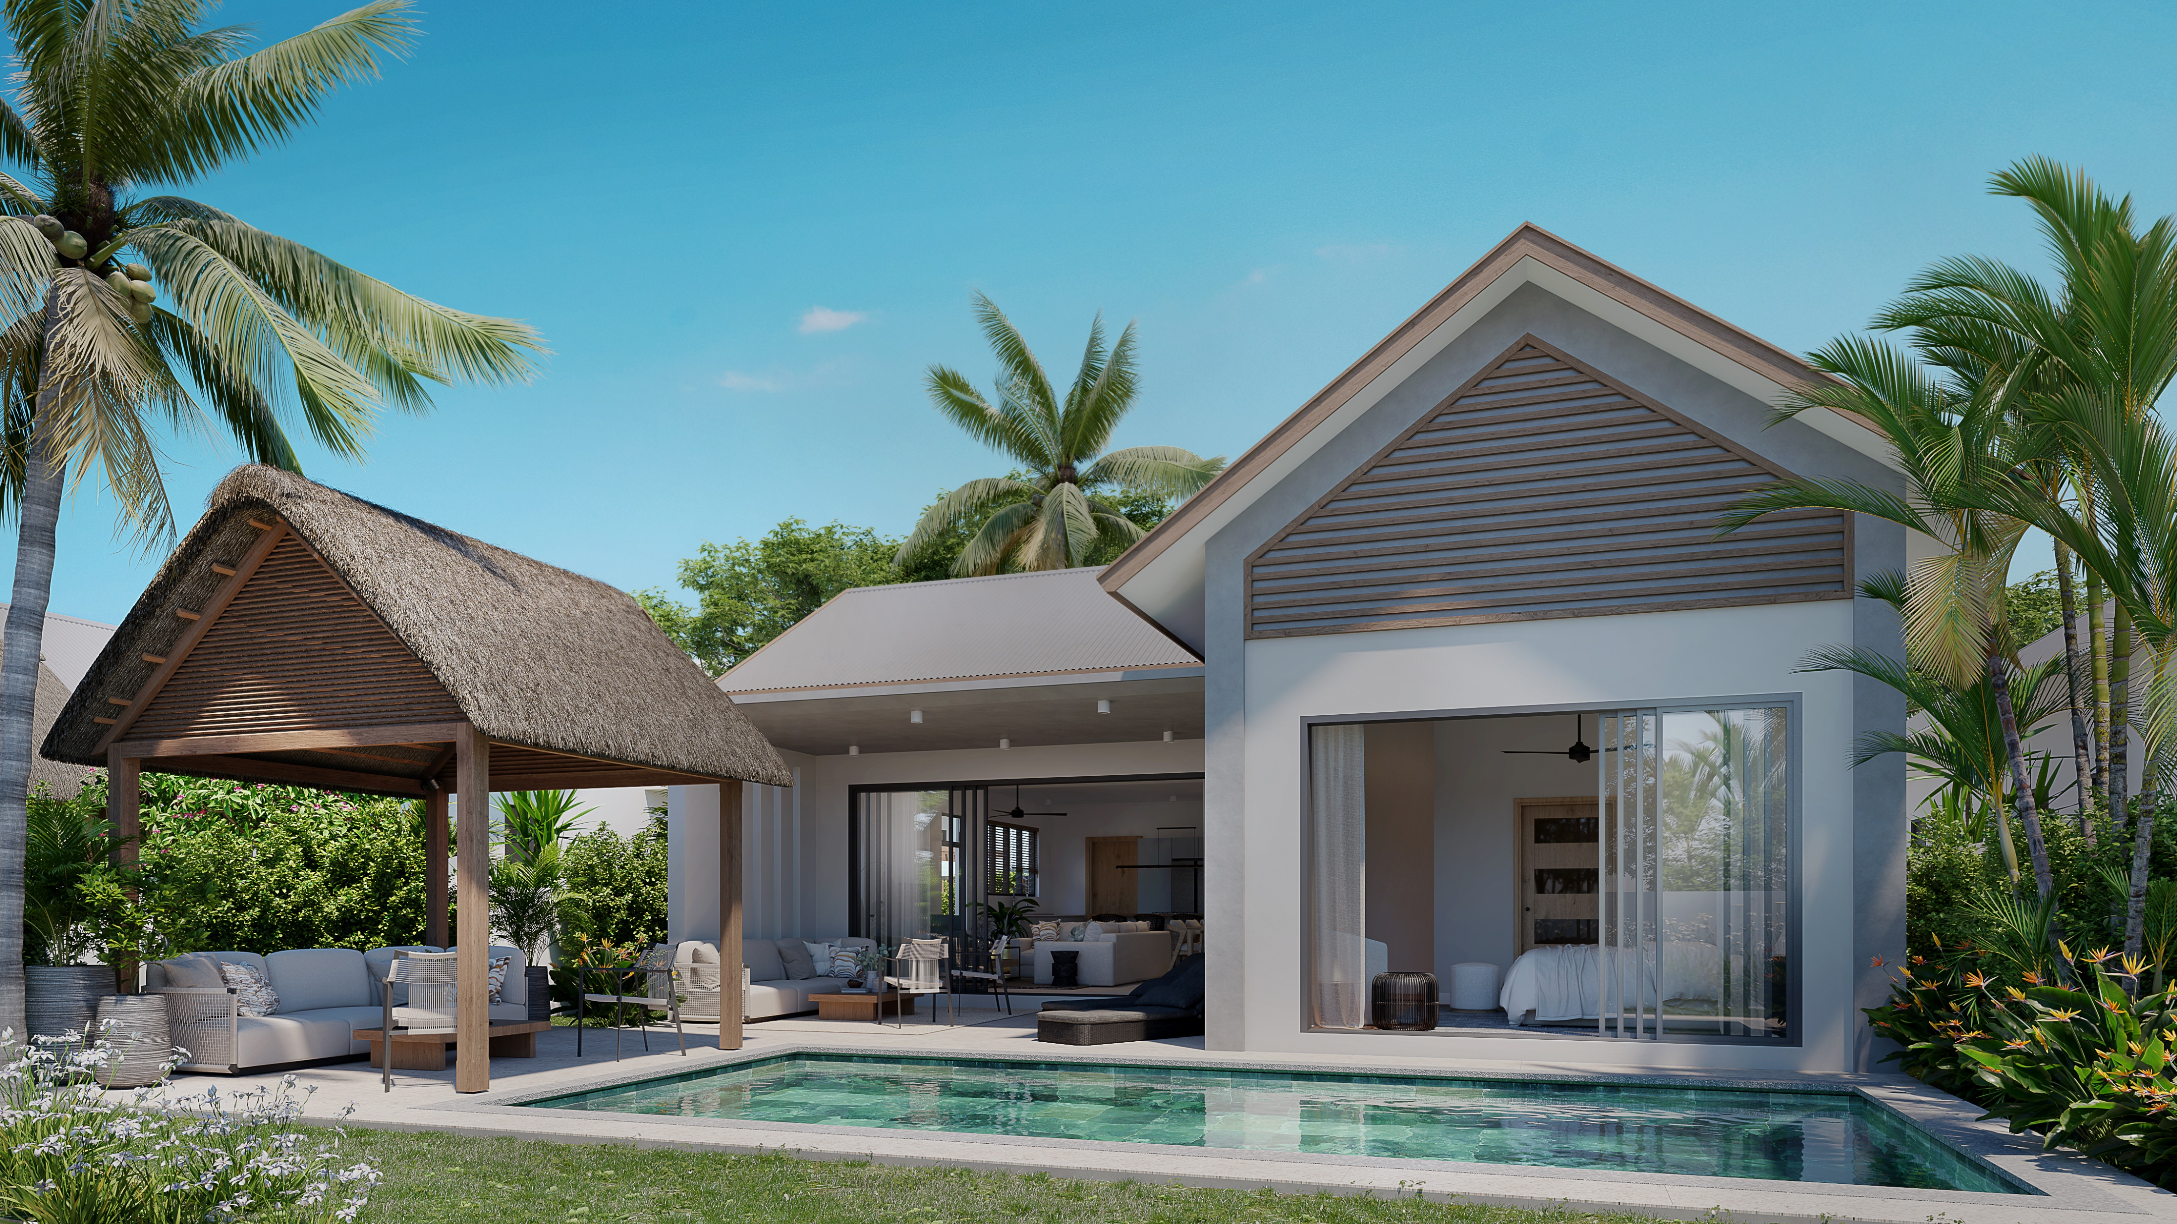
PRESTIGE - EXTERIOR VIEW

Slide 42
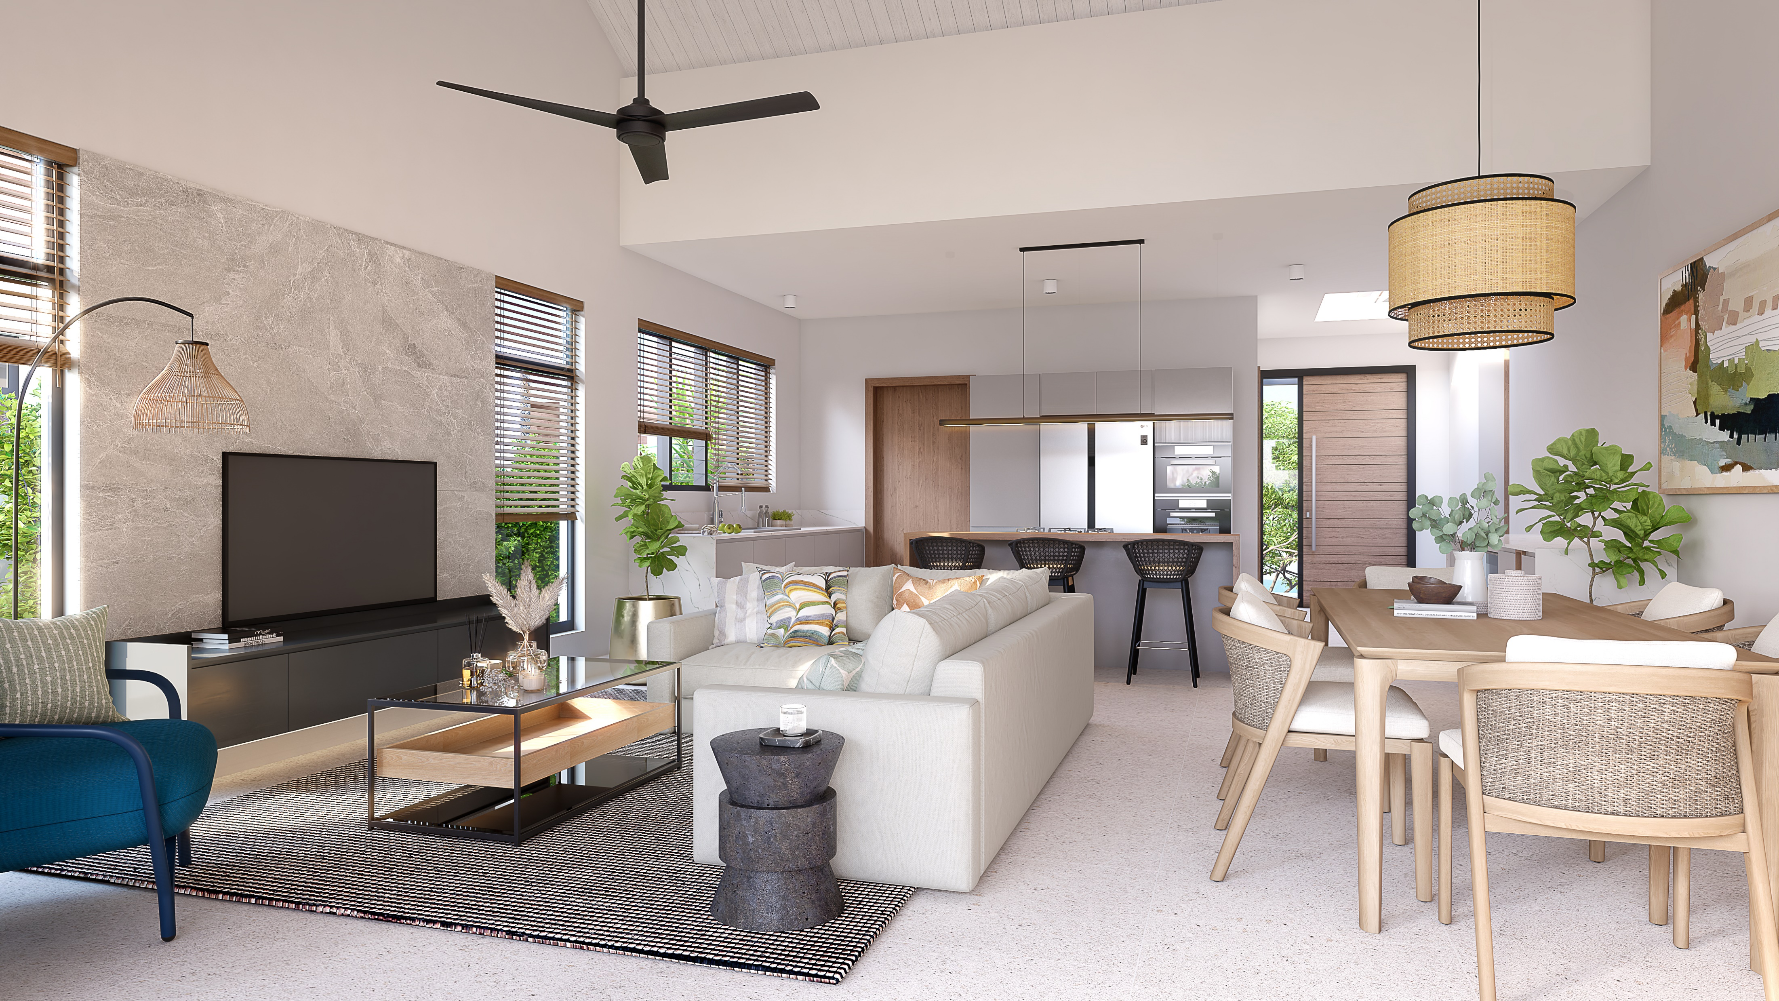
PRESTIGE - KITCHEN/LIVING/DINING

Slide 43
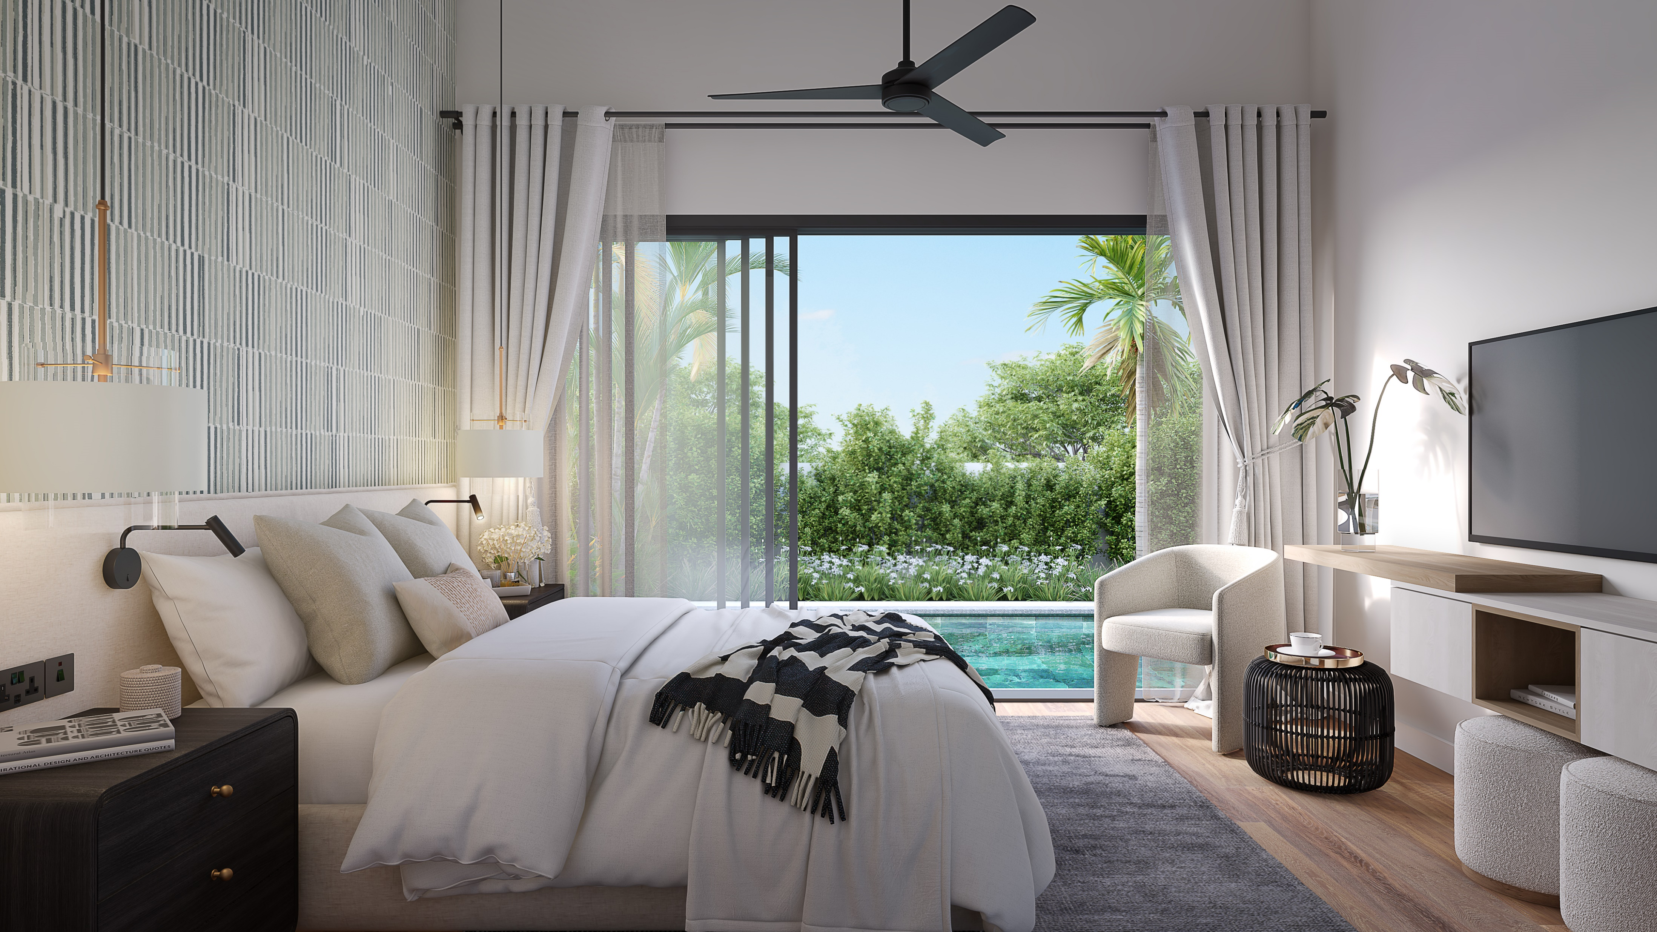
PRESTIGE – MASTER BEDROOM

Slide 44
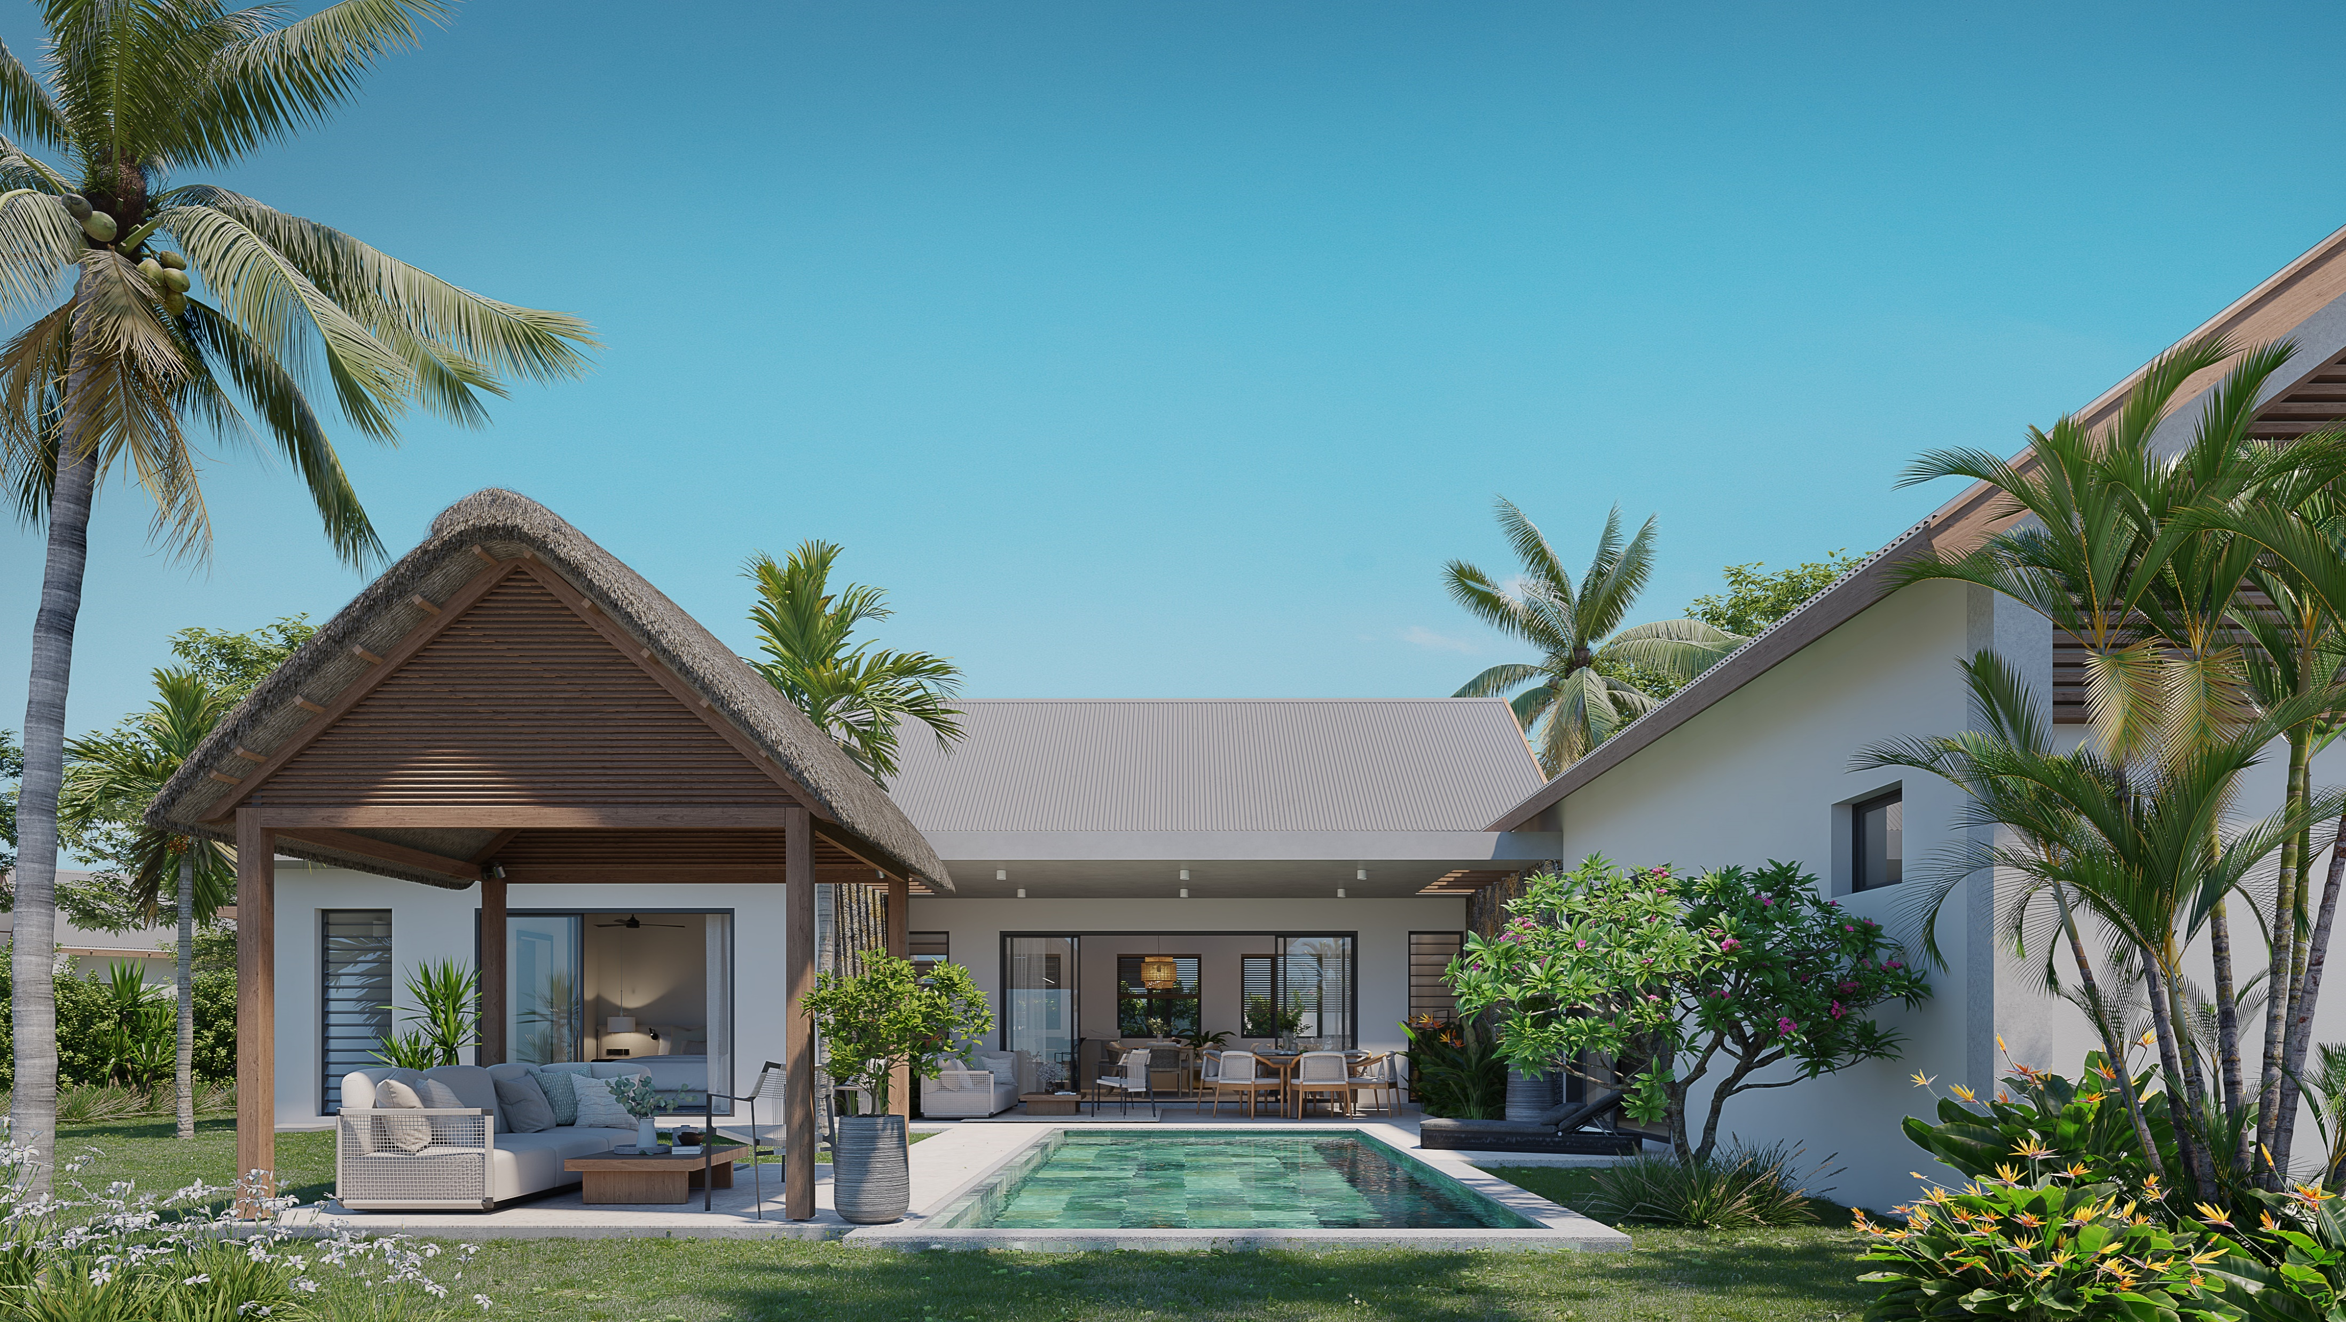
EXCLUSIVE – EXTERNAL VIEW

Slide 45
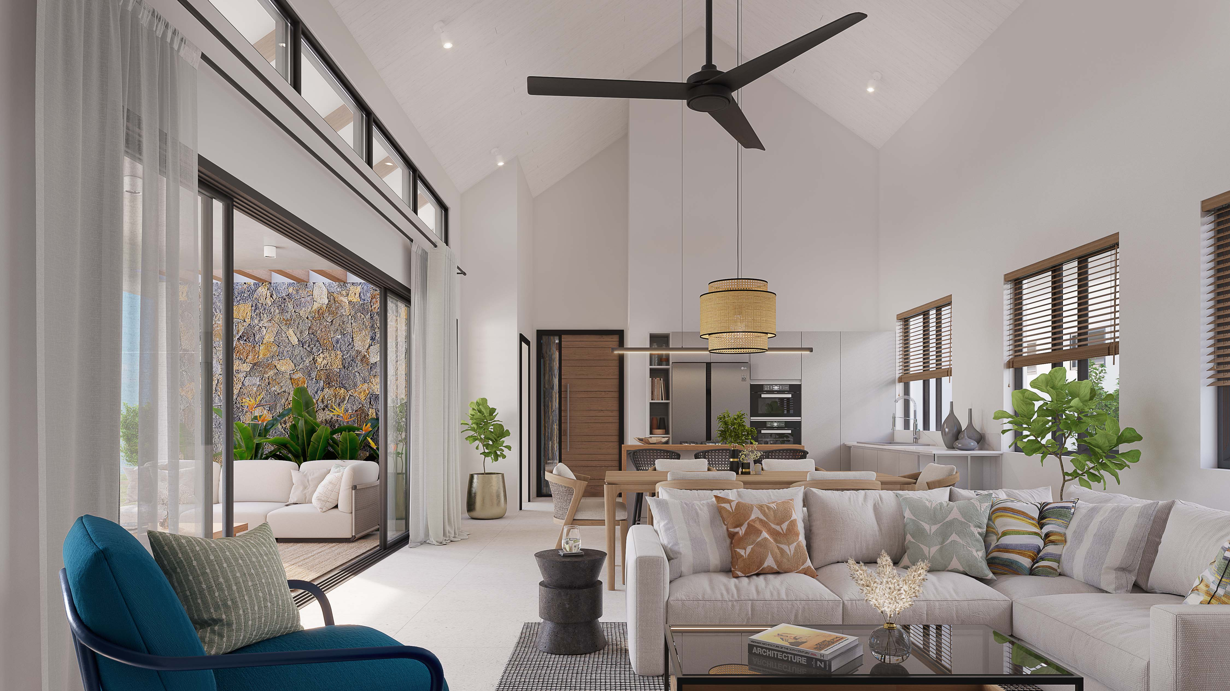
EXCLUSIVE – LOUNGE VIEW

Slide 46
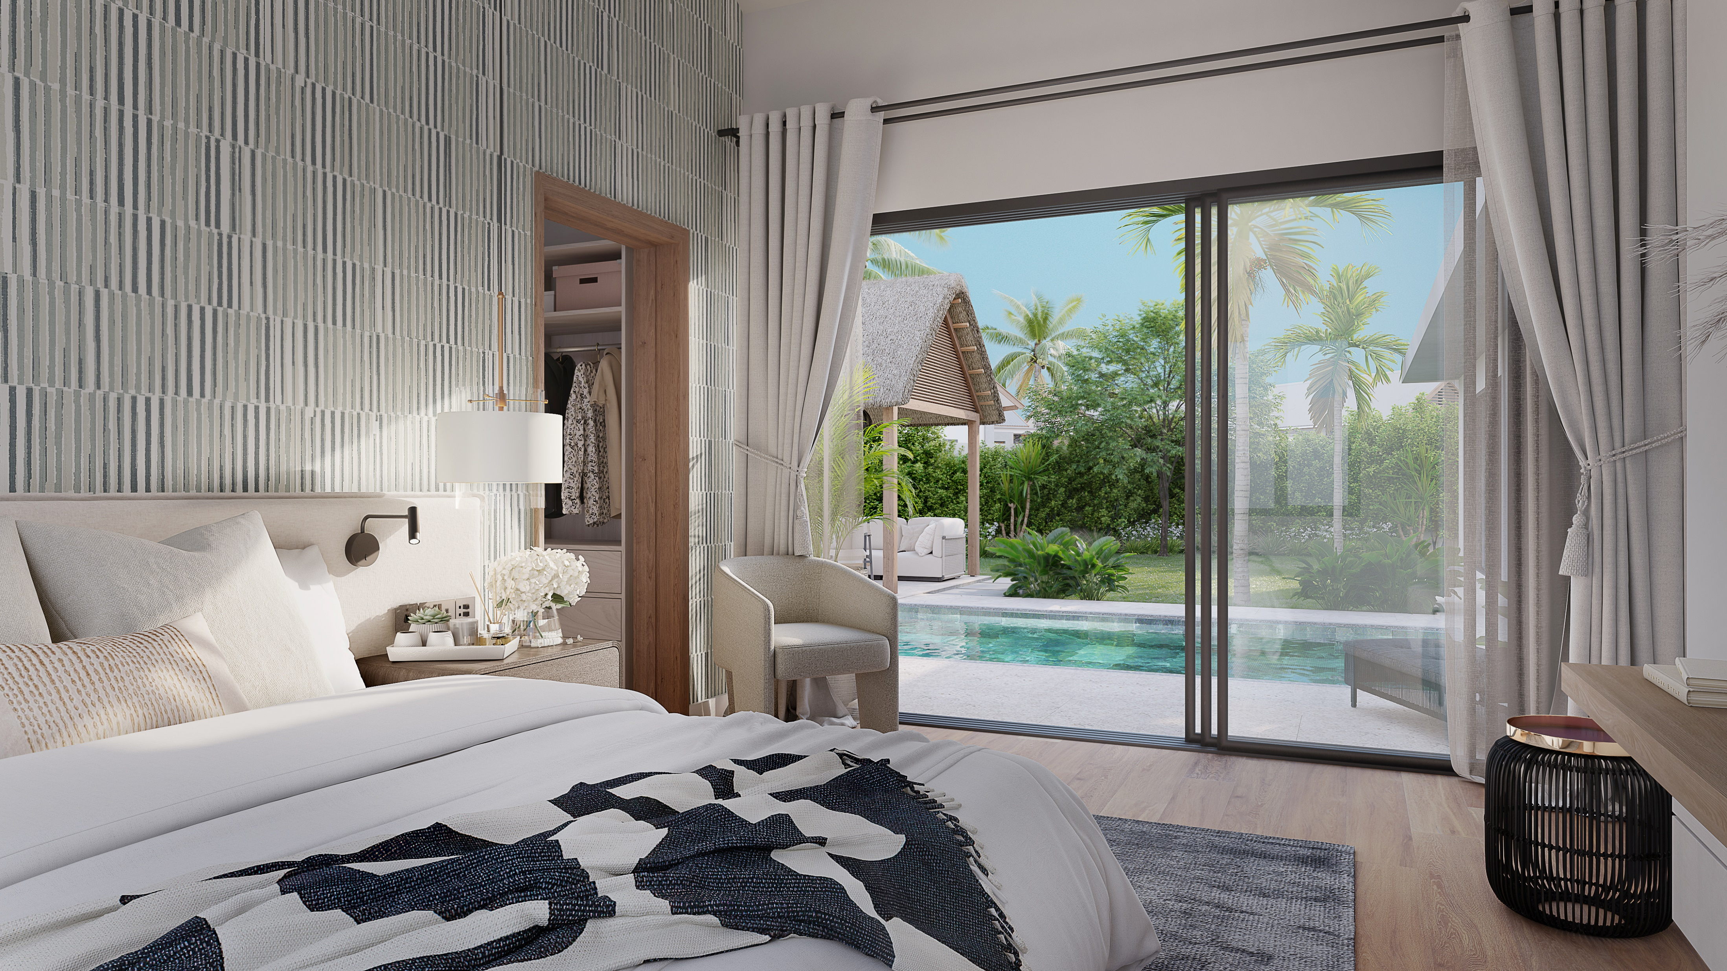
EXCLUSIVE – BEDROOM

Slide 47
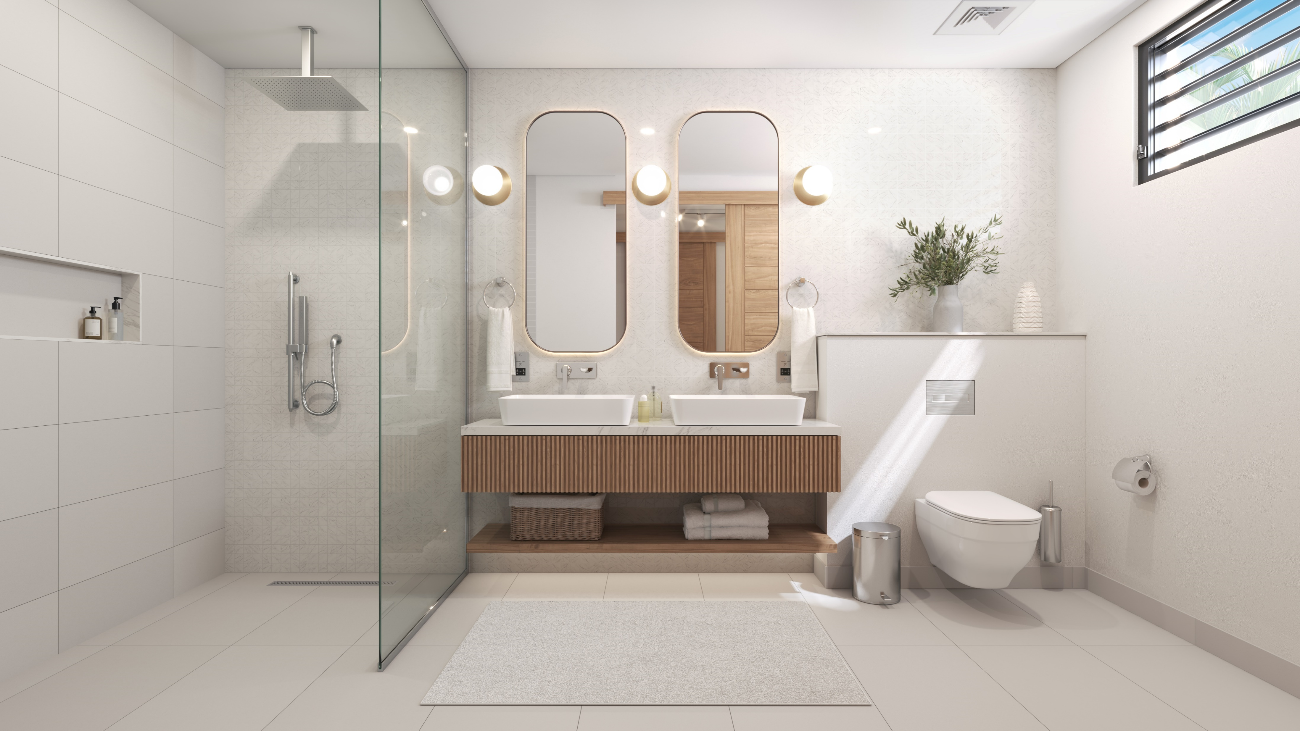
MASTER BATHROOM

Slide 48
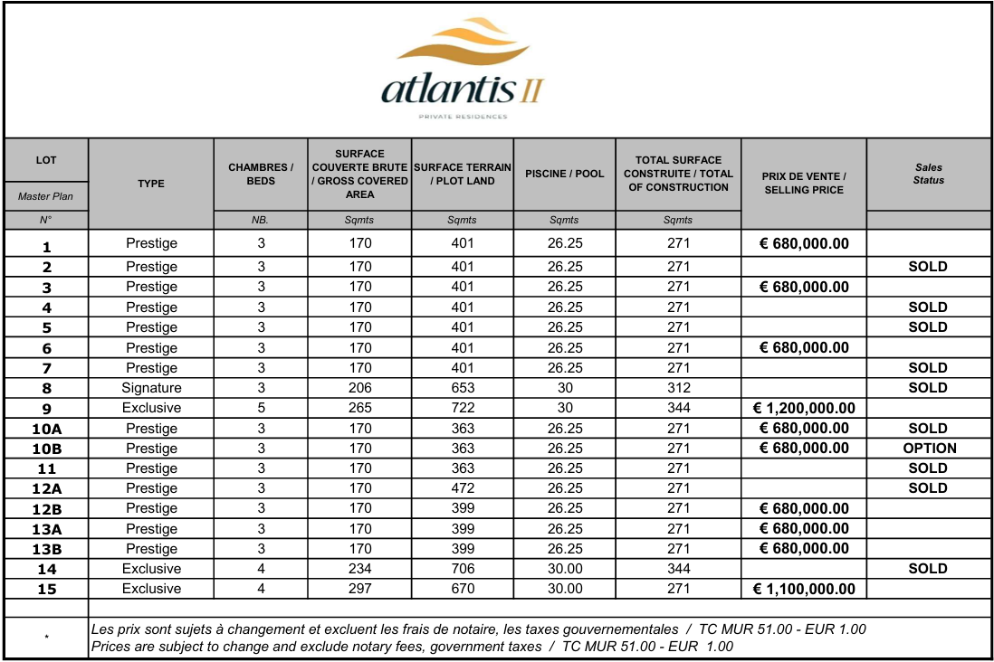
PRICE LIST

Slide 49
Technical Specifications
1 | STRUCTURE
1.1 | Foundation | Traditional foundations and reinforced concrete footings calculated by the BET Structure and verified by the Engineering Control Office
1.2 | Flooring on solid ground | Reinforced concrete slab according to the soil study, thickness to be defined by the BET Structure. Flooring to receive a tiled floor covering.
1.3 | Flooring under the terrace | Reinforced concrete slab with screed to support a tiled floor.
1.4 | Anti -Termite | Anti-termite treatment of the constructed floor area guaranteed for 10 years.
2 | WALLS AND FRAMES
2.1 | Beams and Columns | Columns and beams in reinforced concrete calculated by the BET Structure and checked by the technical control office.
2.2 | External Wall | External walls in hollow block 0.20 cm thick. All walls will be plastered and finished with two coats of paint according to the choice of the architect and the client.
2.3 | Ceiling | Some of the ceilings in the villa will be fitted with water-repellent plaster ceilings. The ceilings will be painted with two layers of paint.
3 | Boundary wall | Boundary wall of the residence with Stones and reinforced concrete as per the technical control office.
3.1 | INTERNAL & EXTERNAL WOODWORKS
3.2 | Entrance Door | Entrance door in varnished solid wood.
3.3 | Internal Doors | Interior doors : painted white,varnished or natural
3.4 | External carpentry | Aluminium windows and patio doors, lacquered and glazed in 8mm, colour according to architect's choice. (Desert grey)
3.5 | Car Port * | Car Port for two cars / Part of the carport can be closed to create a store of 10m² integrated with the main building.

Slide 50
Technical Specifications
4 | Kiosk or Studio* / Lab preparation | Kiosk made of solid wood and roof thatch. / In the place of the kiosk we can prepare a platform with electrical and plumbing to set a studio.
4.1 | Roof
4.2 | Structure | Flat roof in reinforced concrete according to the standards calculated by the BET Structure and checked by the technical control office.
4.3 | Sealing | The roof will be waterproofed with an elastomeric membrane composed of superimposed layers fused with a flashlight.
4.4 | Roof Tops | Slates roof. Roof designed and built to withstand cyclonic winds.
4.5 | Drainage | Drainage points according to engineer study, which will be connected to a water tank for rainwater harvesting.
5 | FLOORING
5.1 | Internal Flooring | Large format coloured porcelain stoneware tiles (75cm x 75cm) in living areas with tiled skirting boards. Tiled floor in wet rooms with matching skirting boards.
5.2 | Outdoor Covered Terrace | Tiled floor on top of screed. Non-slip tiling of outdoor terraces, porches and verandas.
5.3 | Bathroom wall coverings - Shower walls | Tiles in shower only, size and colour to be chosen by the decorator. Mirror above the washbasin in the bathrooms
5.4 | Kitchen | Quartz or granite countertop above the worktops (after installation of the elements of the fitted kitchens)

Slide 51
Technical Specifications
6 | KITCHEN
6.1 | Interior Equipment* - Appliances and Furniture* - Household Equipment | Kitchen equipped with a complete set of furniture and appliances composed of high and low kitchen furniture according to the decorator's layout plan validated by the client. (Technical details available)
6.2* | Household Equipment - Appliances and Furniture | The equipment will include: stainless steel sink, taps, oven, hob, hood, microwave, double door fridge, dishwasher. The appliances will be Siemens or equivalent brands. Quartz or Granite worktop.
6.3* | Pantry Equipment | Functional storage units in contemporary design with worktop, sink and mixer tap and washing machine.
7 | CABINET
7.1 | Rooms | Interior fittings for dressing room with shelves and storage space according to the size of the dressing room
7.2 | Vanity | High quality furniture with granite/quartz countertop, including mirrors.
7.3 | Wardrobe | Interior fittings for wardrobe and/or shelves to the dimensions of the wardrobe
8 | SANITARY
8.1 | WC | Modern, sleek wall-hung toilet.
8.2 | Taps | Mixer taps from Kohler or equivalent. 5 year warranty. For the showers, sets with shower head: shower column with thermostatic mixer
8.3 | Sanitary appliances | Double washbasin for the master room in ceramic. Italian shower, floor and wall tiles.
8.4 | Shower screen | Shower screen in transparent safety glass with aluminium profiles and stainless steel screws.

Slide 52
Technical Specifications
9 | ELECTRICAL INSTALLATIONS
9.1 | Generators | The residence will be equipped with an electrical generator offering a minimum autonomy to allow the functioning of the vital organs of each accommodation (lighting, refrigerators, etc.) in the event of a prolonged power cut
92 | Connection | TV and telephone sockets in the living room and bedrooms, and wiring for fibre optic line and satellite dish. The purchasers will liaise with the service providers under the direction of the developer.
9.3* | Lighting | Equipment to accommodate led bulbs for all light points. And an optional lighting proposal that includes direct and indirect, pendant, fixed, architectural and exterior lighting, taking into account the overall project.
9.4* | Air Conditioning and Ventilation | Cooling of the rooms with the latest generation 12,000 BTU air conditioning and 18,000 BTU in the living area. Ceiling fan in the living room and bedrooms.
9.5 | Socket | Modern socket outlets of the French brands Legrand or Schneider.
10 | PLUMBING
10.1 | Hot and cold water | All polyethylene hot water supply pipes will be fully protected with Armaflex insulated pipe fitting or similar.
10.2 | Solar water heater | Hot water storage and collectors, installed separately from each other, with a capacity of 300L.
11 | Water | The residence will be equipped with a common tank.
11.1 | EXTERNAL
11.2 | Landscaping | The landscaping will be composed of various palm trees and tropical vegetation to maintain the typical appearance of the island.
11.3 | Irrigation | OPTIONAL Automatic watering in sections with a sprinkler and/or drip system.

Slide 53
Technical Specifications
12 | OUTSIDE THE RESIDENCE
12.1 | Driveway | The main driveway will be asphalted with specific sections of cobblestone or evergreen concrete.
12.2 | Parking | Off-road parking with a combination of paving stones and concrete.
12.3 | Water | The common green areas will be provided with water points for the installation of an irrigation system.
13 | SWIMMING POOL
13.1 | Structure | Reinforced concrete structure with a predefined slates.
13.2 | Filtration | Salt filtration.
14 | SECURITY
14.1 | Alarm | Alarm in each villa, connected to an external security company.
14.2 | Fencing | The residence will be surrounded by an electric fence directly connected to a security company.
14.3 | Entrance door | Secure main entrance door.

Slide 54
THANK YOU !

